Slide 1
Try It:
Place two fingers in the hollow of your neck between the windpipe and the large muscle of the neck. Press lightly until you feel a pulse.
We are now going to take our pulse for 15 seconds. When I say “go”, begin to count the number of pulses you feel until I say “stop”.
Now, multiply this number by 4.
  This will give you your beats per minute
How many did you come up with?

Slide 2
Think About It:
A normal human adult resting pulse has between 60-100 beats per minute
Is yours in this range?
How do you think the heart rates of livestock species compare to humans?
When would you think that an animal would have an elevated heart rate?
Why is this important to us?

Slide 3
Circulatory Systems of Livestock Species
By: Ms. Ryan

Slide 4
Objectives:
Define the circulatory system.
Discuss how the circulatory system works.
Define the components of the circulatory system.
Analyze the components of the circulatory systems and their functions.
Describe blood analysis and why it is important.

Slide 5
So What is the Circulatory System Anyway?
Definition: the bodily system consisting of the heart, blood vessels, and blood that circulates throughout the body, delivers nutrients and other essential materials to cells, and removes waste products.
Consists of:
  Heart Veins
  Blood vessels

Slide 6
Circulatory System
Often helps stabilize body temperature and pH
Can you think of an example of this in humans?
  Going into shock if your blood pressure is at an extremely low level
  Others?

Slide 7
How It Works
Vertebrates have a closed circulatory system, which generally confines the blood within its walls
Blood flows through two circuits through a partitioned heart that works as two side by side pumps
This double circuit supports the high levels of activity that is characteristic of most vertebrates

Slide 8
The Heart
Definition: a four-chambered, hollow muscle used to pump blood.
Divide into four compartments:
Ventricles: pump blood into arteries
Atrium: the chamber of the heart that receives blood
Left Ventricle | Left Atrium
Right Ventricle | Right Atrium

Slide 9
The heart
Right side of the Heart:
  pumps deoxygenated blood (blood low in Oxygen) to the lungs
Left side of the Heart:
  pumps oxygenated blood (blood rich in Oxygen) all over the body

Slide 10
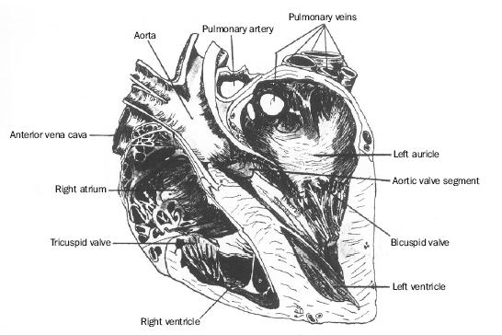
Cross Section of A Horse’s Heart

Slide 11
Blood Vessels
Three kinds: arteries, capillaries, veins
Arteries: carry blood away from the heart
  Divide into arterioles, which are small arteries that are controlled by the nervous system to regulate blood pressure
Capillaries: microscopic blood vessels with a wall formed of one layer of simple squamous cells
  Beds of capillaries are very prevalent in the body
  When an animal eats, capillary beds of the digestive system open
  So narrow that red blood cells must pass through in single file

Slide 12
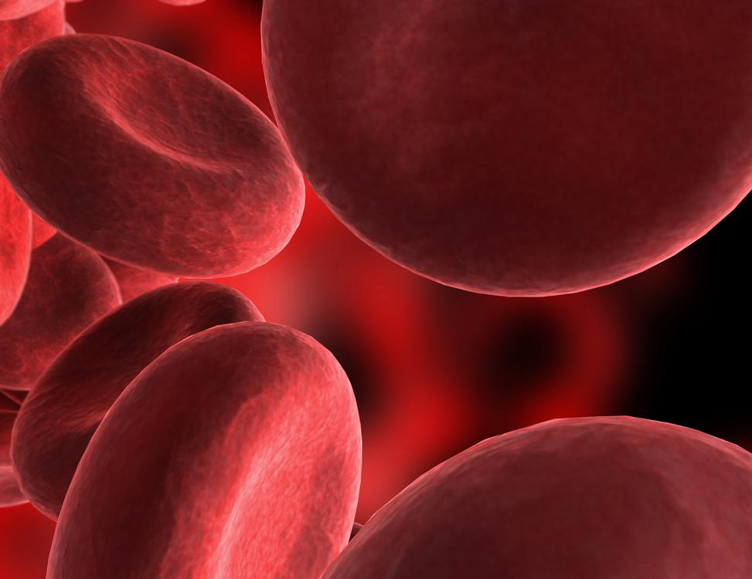
Blood Vessels
Venules: vessels that take blood from capillaries and join to form a vein
Veins: transport blood toward the heart
  Walls are much thinner than arteries
  No blood pressure
  One-way valves open in the direction of the heart and close to prevent back flow

Slide 13
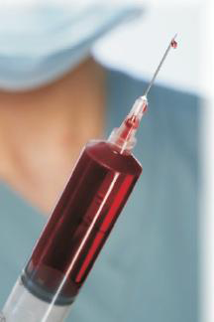
Blood
Blood: the liquid in the circulatory system of an animal organism
Organisms cannot live without it
All animals have it, but its nature varies from one species to another
Amount varies with the species and size of animal

Slide 14
Blood
An average adult human weighing 160 pounds has about 5 quarts of blood
Animals in high altitudes have more blood than those at lower altitudes because air at higher altitudes has less oxygen
What do you think will happen if animals from higher altitudes are moved to lower altitudes?

Slide 15
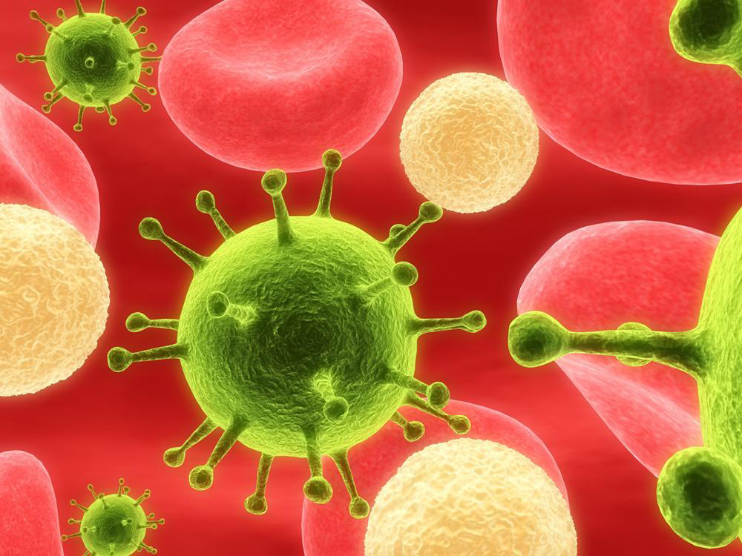
Blood Consists of:
Plasma: the liquid substance in which various solid materials are suspended and moved about
  90% water
  10% = dissolved substances including hormones, wastes, minerals, vitamins, and proteins

Slide 16
Blood Consists of:
Red blood cells: responsible for carrying oxygen from the lungs throughout the circulatory sysem
  Oxygen carried by hemoglobin: a protein part of the blood
  Do not repair themselves
  New cells are made in bone marrow
  Dead cells are removed by the spleen and liver
  One animal may have a trillion blood cells!

Slide 17
Blood Consists of:
White blood cells: responsible for fighting disease and removing harmful substances from the body
  Four different kinds found in blood
  Some cells surround and digest infectious bacteria
  Produce antibodies: a kind of protein that destroys bacteria, viruses, and other invasive substances
WBC counts go up if there is an infection

Slide 18
Blood Consists of:
Platelets: the structures in blood that are responsible for clotting
  Disk-like shape
  Creates scabs
  Without them, an animal might bleed to death from a wound

Slide 19
The Actual Process:
Heart pumps blood into the body through arteries and capillaries
Blood returns in the veins
Circulation includes moving blood:
  through the lungs by receiving oxygen and giving off carbon dioxide
  by the liver and spleen for cleaning
  throughout the entire body to support life processes

Slide 20
Blood’s Role as a Transport
Carries oxygen to all areas of the body and acquires carbon dioxide from the respiration process in the cells
Protects against disease (white blood cells)
Transport hormones
Transport nutrients and wastes
Heat regulation
  Skin uses some of the liquid in blood as sweat

Slide 21
Maintaining Blood Supply
Regulation
  Amount of blood and proportions of materials in blood is regularly being adjusted to meet demands of the body
Replacing worn cells
  Blood cells and platelets produced in bone marrow
  Marrow: the soft substance in the middle of bones, can be red or yellow

Slide 22
Maintaining Blood Supply
Controlling bleeding
  Coagulation: a complex process initiated by injured tissues giving off signals indicating bleeding is occuring
  Clotting factors result in formation of
  fibrin: creates a blockage that stops the loss of blood from the wound
  Blood also has substances that dissolve clots where they are not needed
  (example: arteries)

Slide 23
Maintaining Blood Supply
Organisms that lose blood may be given blood taken from another animal with the same blood type, which is called a
blood transfusion
  More common in humans and domesticated animals
  Can transmit disease
  Should only be done by trained individuals

Slide 24
Blood Analysis
Definition: the process of testing blood to determine its characteristics
Samples collected and tested
Primarily used in determining an animal’s health
Also used to determine nutritional adequacy
  Anemia: the condition caused by inadequate Iron

Slide 25
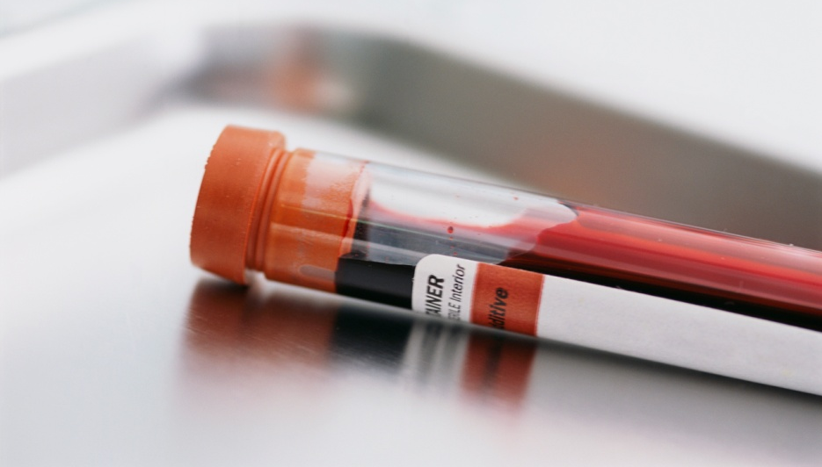
Blood Analysis
Determine the presence of pathogens, which are microorganisms that cause disease
Blood poisoning: a condition in the blood caused by the presence of bacteria or fungi that cause disease

Slide 26
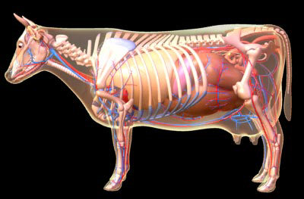
Circulatory System of Cattle

Slide 27
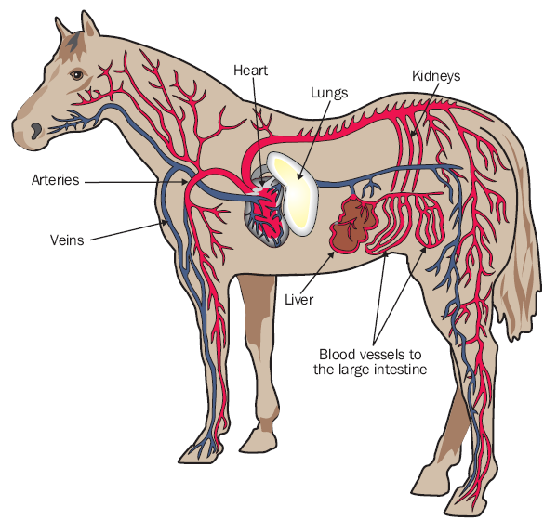
Equine Circulatory System

Slide 28
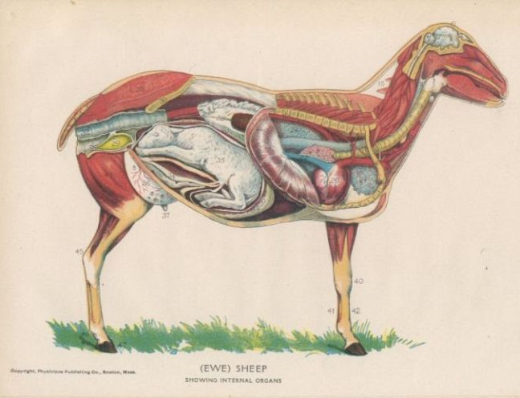
Ovine Circulatory System

Slide 29
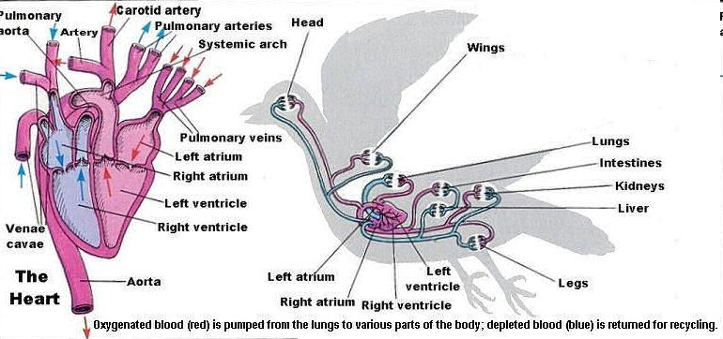
Circulatory System of Poultry
Department of Biological Sciences. Eastern Kentucky University BIO 554 Ornithology

Slide 30
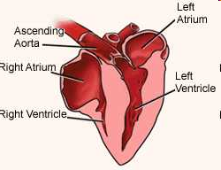
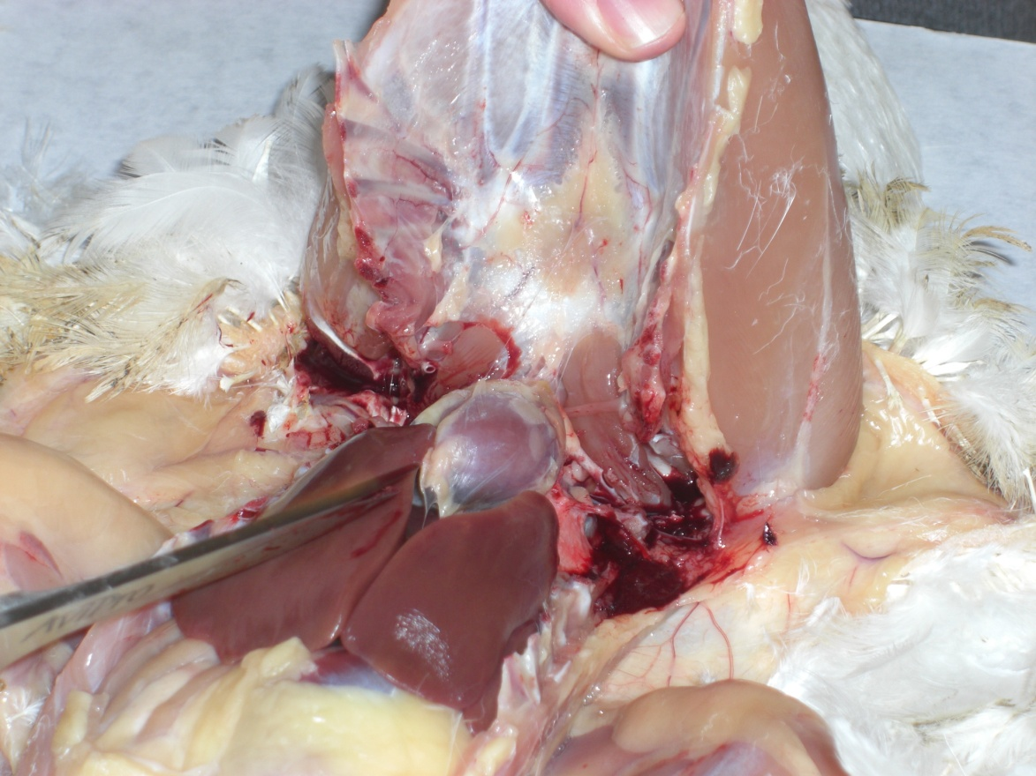
Circulatory System of Poultry

Slide 31
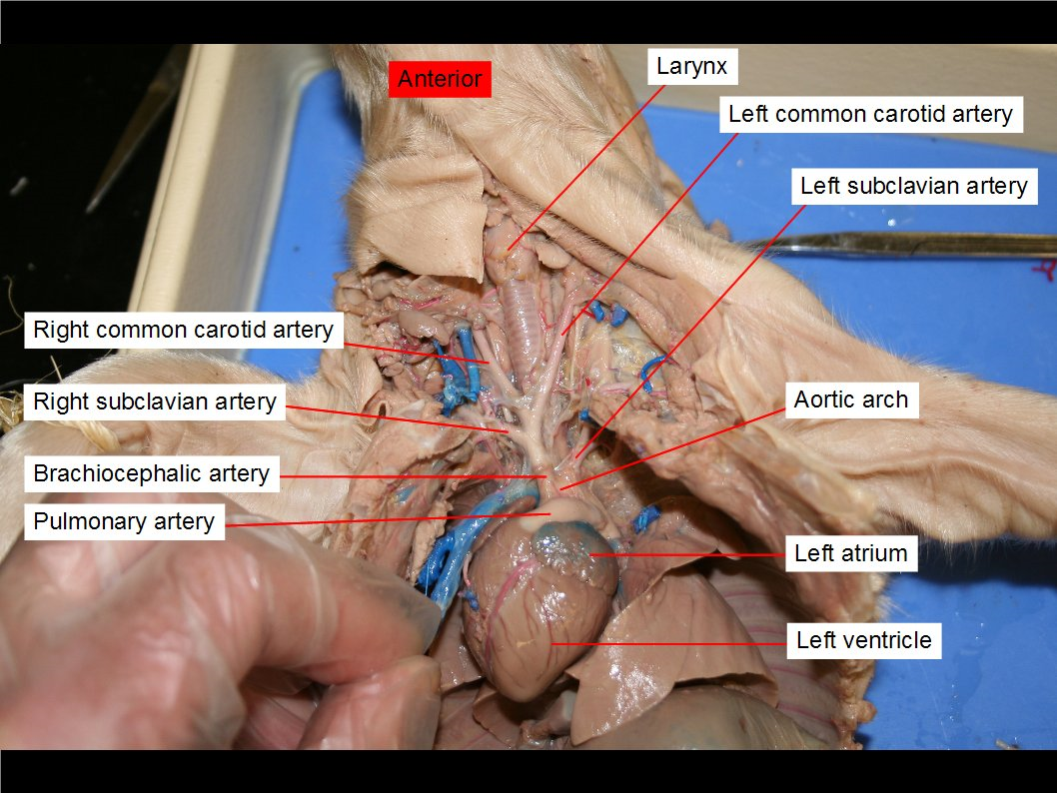
Circulatory System of Swine

Slide 32
Review
What are the 4 compartments of the heart?
  Left and right atriums, left and right ventricles
Does the right side of the heart pump oxygenated or deoxygenated blood to the lungs?
  Deoxygenated
True or False: The left side of the heart pumps oxygenated blood all over the body.
  True

Slide 33
Review
What are the three kinds of blood vessels?
  Arteries, capillaries, veins
What are the small arteries that are controlled by the Central Nervous System and regulate blood pressure?
  Arterioles
Do arteries carry blood away from the heart or to the heart?
  Away from the heart

Slide 34
Review
True or False: Veins transport blood toward the heart
  True
__________ are the vessels that take blood from capillaries and join to form a vein
  Venules

Slide 35
Review
An average adult human weighing 160 pounds has about how many quarts of blood?
  5 Quarts
True or False: Animals in high altitudes have less blood than those at lower altitudes
  False

