Slide 1
Equine Nutrition
Matt McMillan, Ph.D.

Slide 2
Equine Nutrition
What do we consider a horse?
What is included in the GI Tract?
What is horse feed?
Why do we feed grain?

Slide 3
Feeding Management
What 2 variables determines
  How much a horse needs to eat daily?
    Stage of Life
    Level of Activity
      Young vs. Old
      Idle vs. Working
      Open vs. Lactating

Slide 4
Feeding Management
What 2 feeds required for life by all horses in all situations?
  Water
  Forage
  Ad-libitum of both is ideal except for
    The overweight horse

Slide 5
Water Feeding
How should water be fed?
  Before and during prolonged exercise?
    Allowed to consume as much as possible
  Following Exercise?
    Should be cooled down before allowing to drink
  Can over consumption of water cause problems?
    Colic and/or laminitis
  All other times?
    Adequate quantities is important

Slide 6
Water Feeding
Does water intake effect digestibility of feed stuffs?
  No
  Whether drinking before or after feeding
    Does not affect feed digestibility
Thirsty horses will have
  reduced feed intake

Slide 7
Forage Feeding
Is Forage necessary in the diet?
Forage is required for what?
  Fiber
Digestible fiber is used for what?
  Energy
Indigestible fiber is also important

Slide 8
Forage Feeding
Indigestible fiber is required for
  Maintenance of normal gastrointestinal:
      pH
      Motility
      Function
Also helps to prevent what?
  Too rapid of an intake

Slide 9
Forage Feeding
How much forage should a horse receive daily?
  At least 1% BW/d in forage
What can inadequate forage lead to?
  Digestive upsets
  Vices

Slide 10
Forage Feeding
Idle horses have been maintained at
  0.5% BW/d
    Remainder of energy needs provided in grain
    Is this good?

Slide 11
Forage Feeding
How should forages be fed?
  In a manner that minimizes:
    Forage losses
    Forage fecal contamination
      (↑internal parasites)
    Dust inhalation

Slide 12
Forage Feeding
Some say:
  Harvested feeds should be fed in hay racks
Others say:
  Forage should be fed on the ground
    Parasites?
    Foreign inhalation?
    Natural intake?
    Waste?

Slide 13
Grain Feeding
How many coffee cans does it take to feed a horse?
Do all concentrates weigh the same?
We should:
  Feed by weight, not by volume

Slide 14
Grain Feeding
When do we need to feed grain?
    Energy needs cannot be provided by feeding forages alone
    Forages are poorly available
    Desired for other reasons
      Ex: to catch

Slide 15
Grain Feeding
Grains and forages are generally fed at the same time
Most horses will consume grain first
Grains should be fed in a feeder

Slide 16
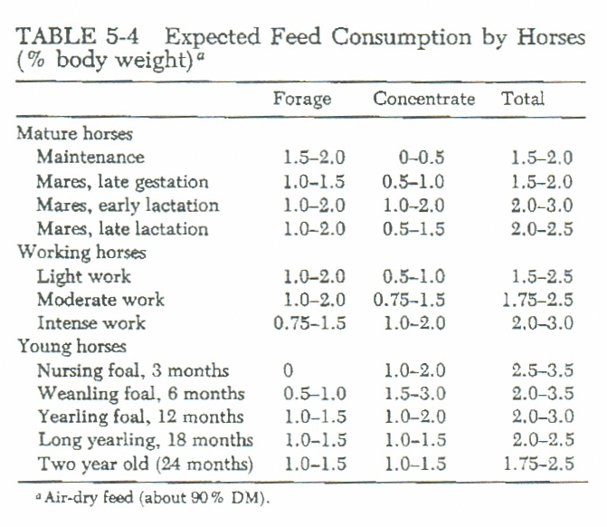
General Horse Feeding Practices

Slide 17
Feeding Frequency
  Stomach comprises of what % of the G.I. Tract?
    ~7%
  How much time does spent grazing?
    ~50 to 70% of their time grazing
  How many times day should grain be fed?
    In general, 2 to 3 times/d
    Many times as possible
      Decreases chance of colic

Slide 18
Feeding Amts and Frequency
Recommended that all feeds be fed:
    In equally divided amounts
    As near the same time each day
    At least twice daily

Slide 19
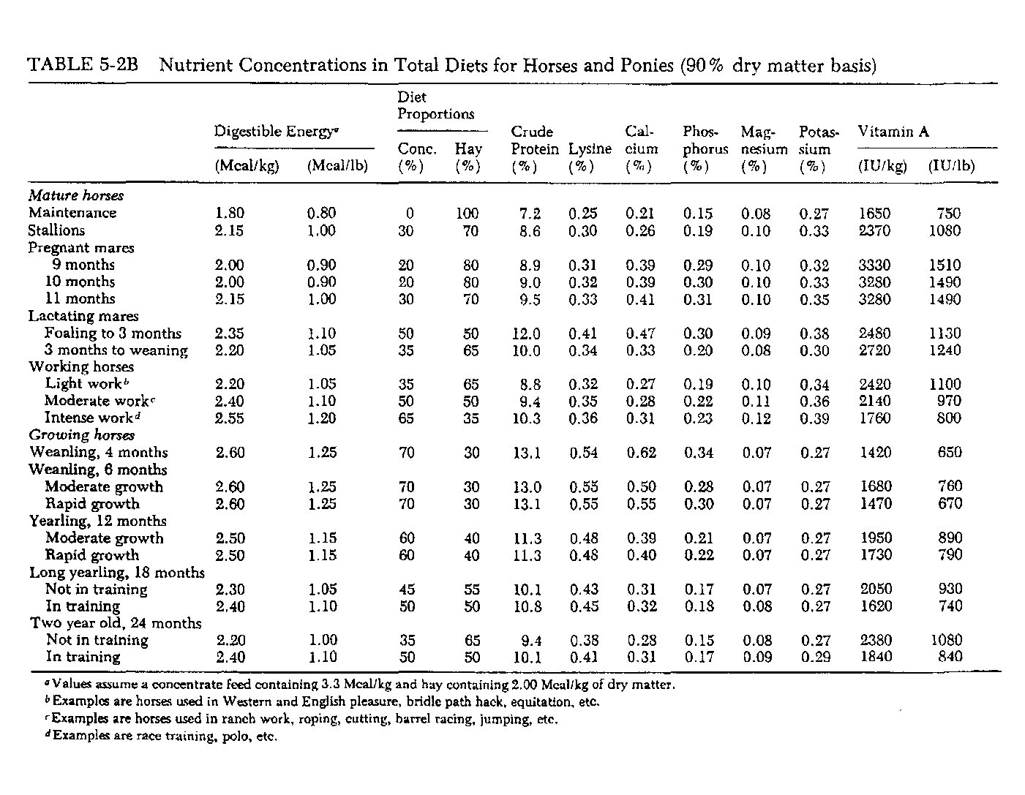

Slide 20
Nutritional & Health Status
Nutritional and health status should be observed
  1 – 2 times daily
Observed for:
  Injuries
  Attitude
  Feeding behavior
    including: appetite, eagerness to eat, and amount consumed

Slide 21
Nutritional & Health Status
What causes of poor intake?
  Sore tongue or bad teeth
  Moldy or contaminated feeds
Any signs of reduced intake should warrant concern
Any signs of abnormal feces should also cause concern

Slide 22
Changing Diets
How should diets be changed?
  Gradually
How should you increase feed intake?
  Slowly
When feed is changed, initial intake may
  Go Down
  Does not mean the feed is bad
    only that the horse is not accustomed

Slide 23
Digestive Upsets
Are digestive upsets common?
What is colic?
Are their different types of colic?
What causes colic?

Slide 24
Common Causes of Colic
Epidemiological Studies
Internal Parasites
Stall Confinement for more than
  15 hours per day
Feeding Large Amounts of Grain
  > 12 lbs per day
Participation in intensive exercise
Feeding grain before hay after a “fast”

Slide 25
Common Causes of Colic
Dehydration
  Water
  Salt
  Minerals (especially electrolytes)
Inadequate Forage Quality
  Too High or Too Low
Inadequate Forage Quantity

Slide 26
So How Do We Prevent Colic?
Provide plenty of
  Good, clean, fresh water
Provide adequate forage
  Quantity and Quality
If feeding > 5 lbs./d
  Break into multiple feeding times

Slide 27
So How Do We Prevent Colic?
Regular
  De-worming
  Vaccinating
  Teeth floating regimes
Side note: >90% of digestive upsets are due to
  Feed management rather than feed source

Slide 28
Evaluating Commercial Horse Feeds

Slide 29
Feed Labeling Regulations
Required by all commercial feed manufacturers
Controlled by regulatory agencies:
  American Feed Control Officials (AFCO)
  American Feed Industry Association (AFIA)
  State Chemist

Slide 30
Model Feed Bill
Includes definitions, registration of brand feed names, labeling, etc.
Tag information must include:
  Weight
  Company Name
  Product Name
  Directions
  Guaranteed Analysis
  Ingredients (Common name or collective terms)
  Precautionary statement
  Name and mailing address of manufacturer

Slide 31
Ingredient Listing
Usually are listed with the item making up the largest percent of mixture
  However, not required
Collective feed names:
  Animal Protein Products
  Plant Protein Products
  Processed Grain By-Products
  Forage Products
  Roughage Products

Slide 32
Guaranteed Analysis
Provide information on:
  Protein
  Fat
  Fiber
  Minerals
  Vitamins
Guarantees are not exact!!

Slide 33
Commercial Feed Classes
Textured Feeds (Sweet Feed)
  May or may not be processed
  Example: crimped, cracked, rolled, flaked
Processed Concentrates
  Pellets
  Extruded Feeds
Complete Feeds
Supplements
  Protein Trace Mineral and/or vitamin

Slide 34
Feedstuffs
Corn, Oats, Barley
Molasses
Soybean Meal and Cottonseed Meal
Wheat Middlings, Rice Hulls, Corn Gluten Feed
Rice Bran, Flax Meal, Alfalfa Meal
Beet Pulp

Slide 35
Feed Tag Evaluation
By law, feed companies are required to
  List standard nutrient content of feed
Must display:
  Minimum % CP
  Minimum % Fat
  Maximum % CF
  Min. & Max. Ca
  Minimum P
  Minimum NaCl

Slide 36
Nutrient Evaluation
Most horse owners place emphasis on what?
  Crude Protein
Other things to consider?
  Amino Acid Profiles
  Ca:P ratio
  Fat Content
  Fiber Content
  Value added products
  Ingredients

Slide 37
Nutrient Evaluation
What agency regularly samples and tests finished feed products?
  Texas State Chemist Feed Control Officials

Slide 38
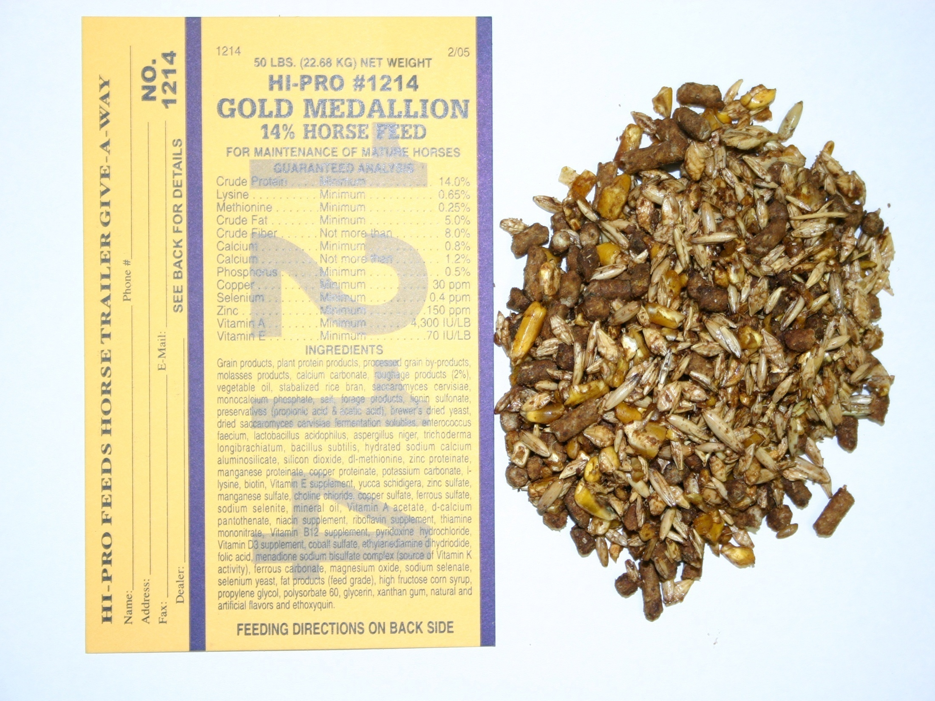

Slide 39
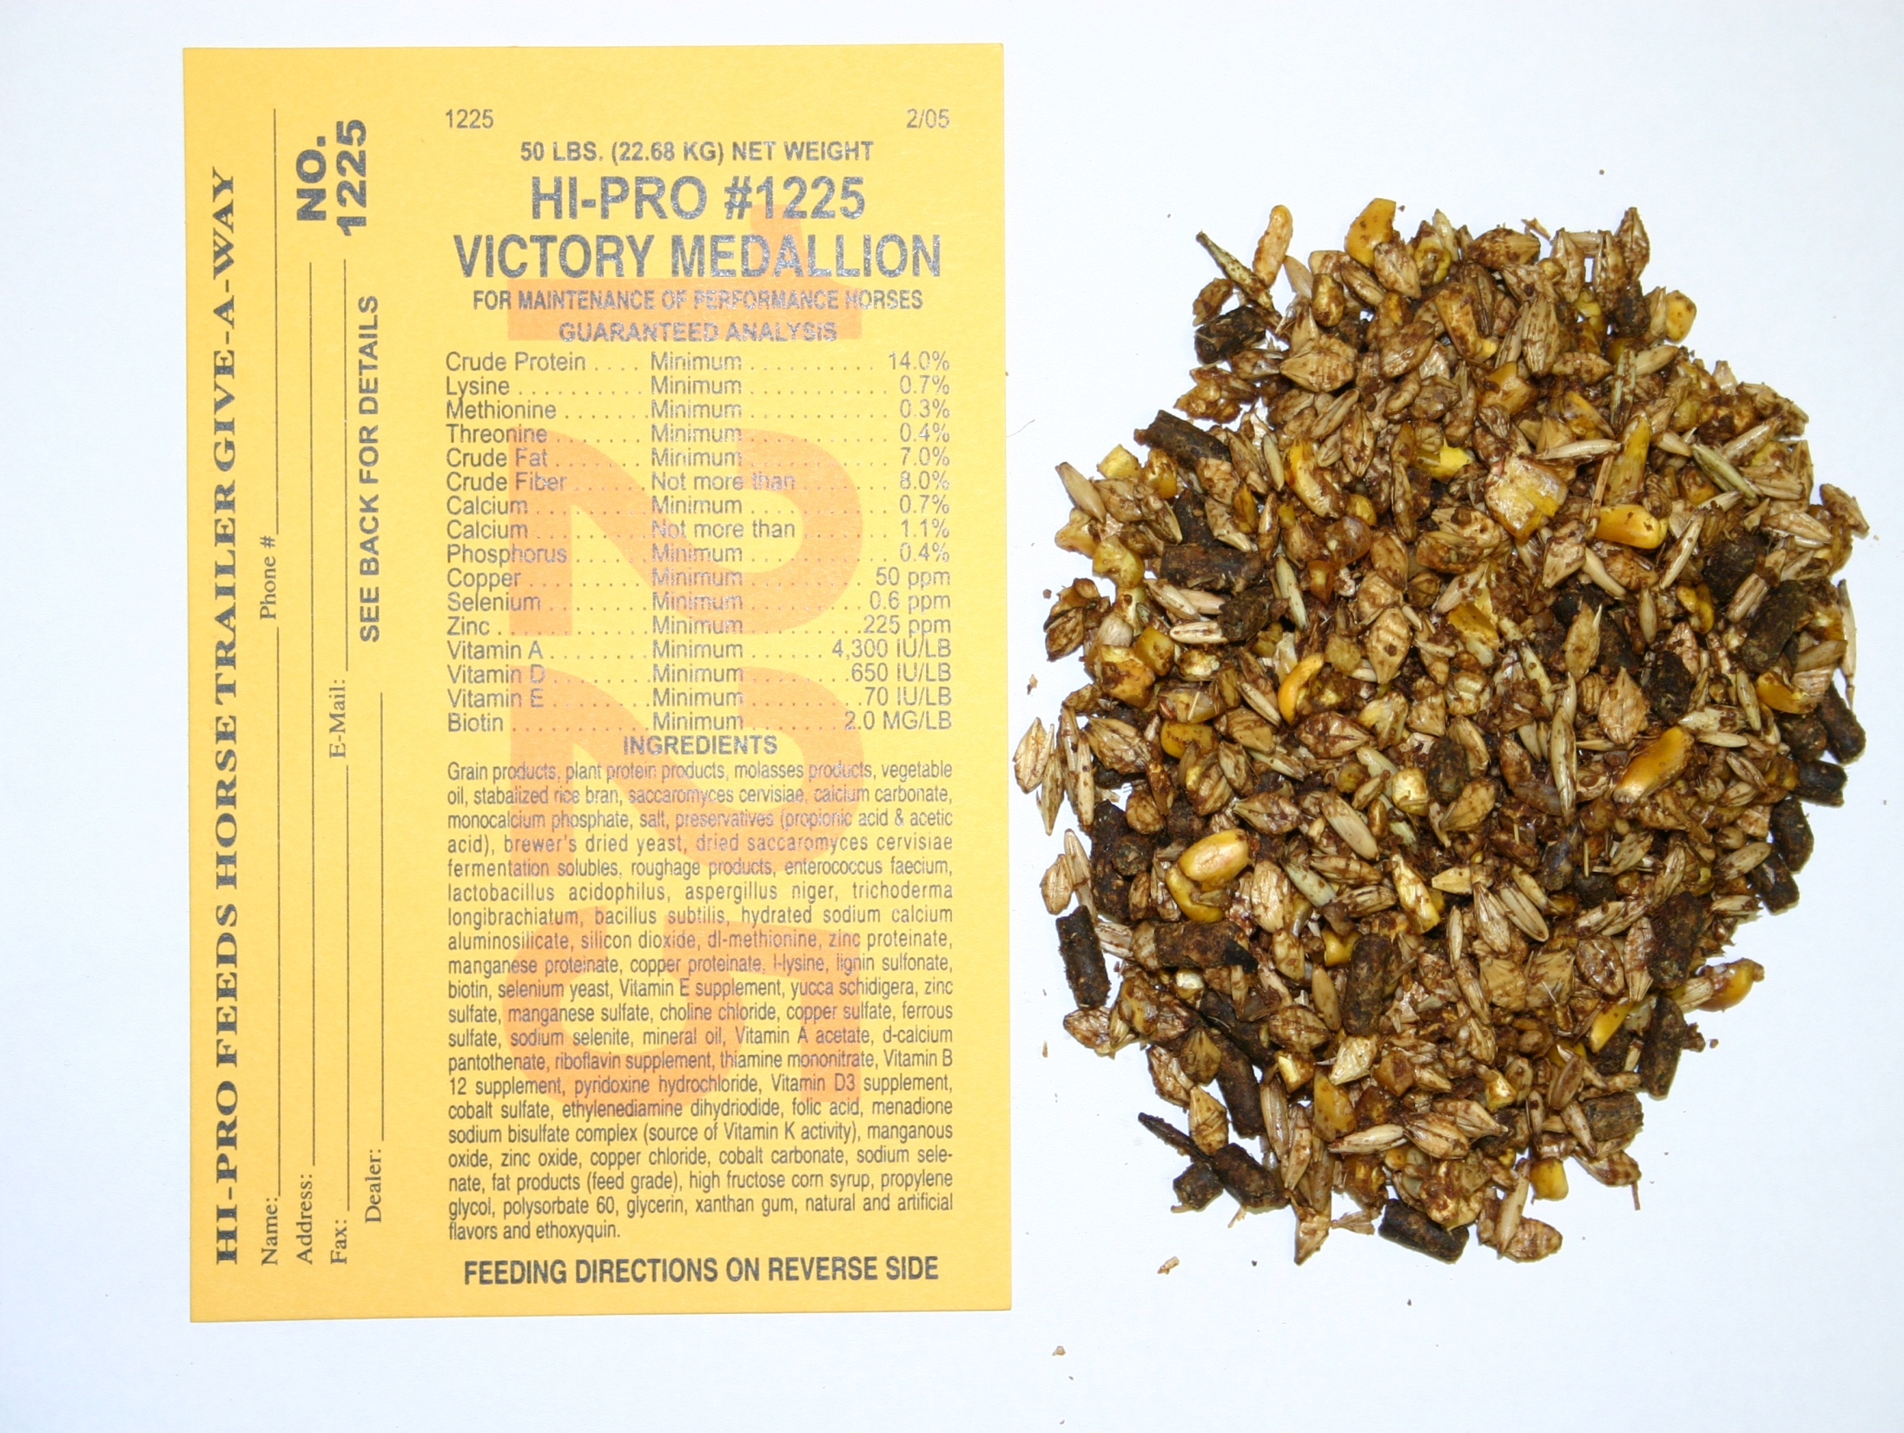

Slide 40
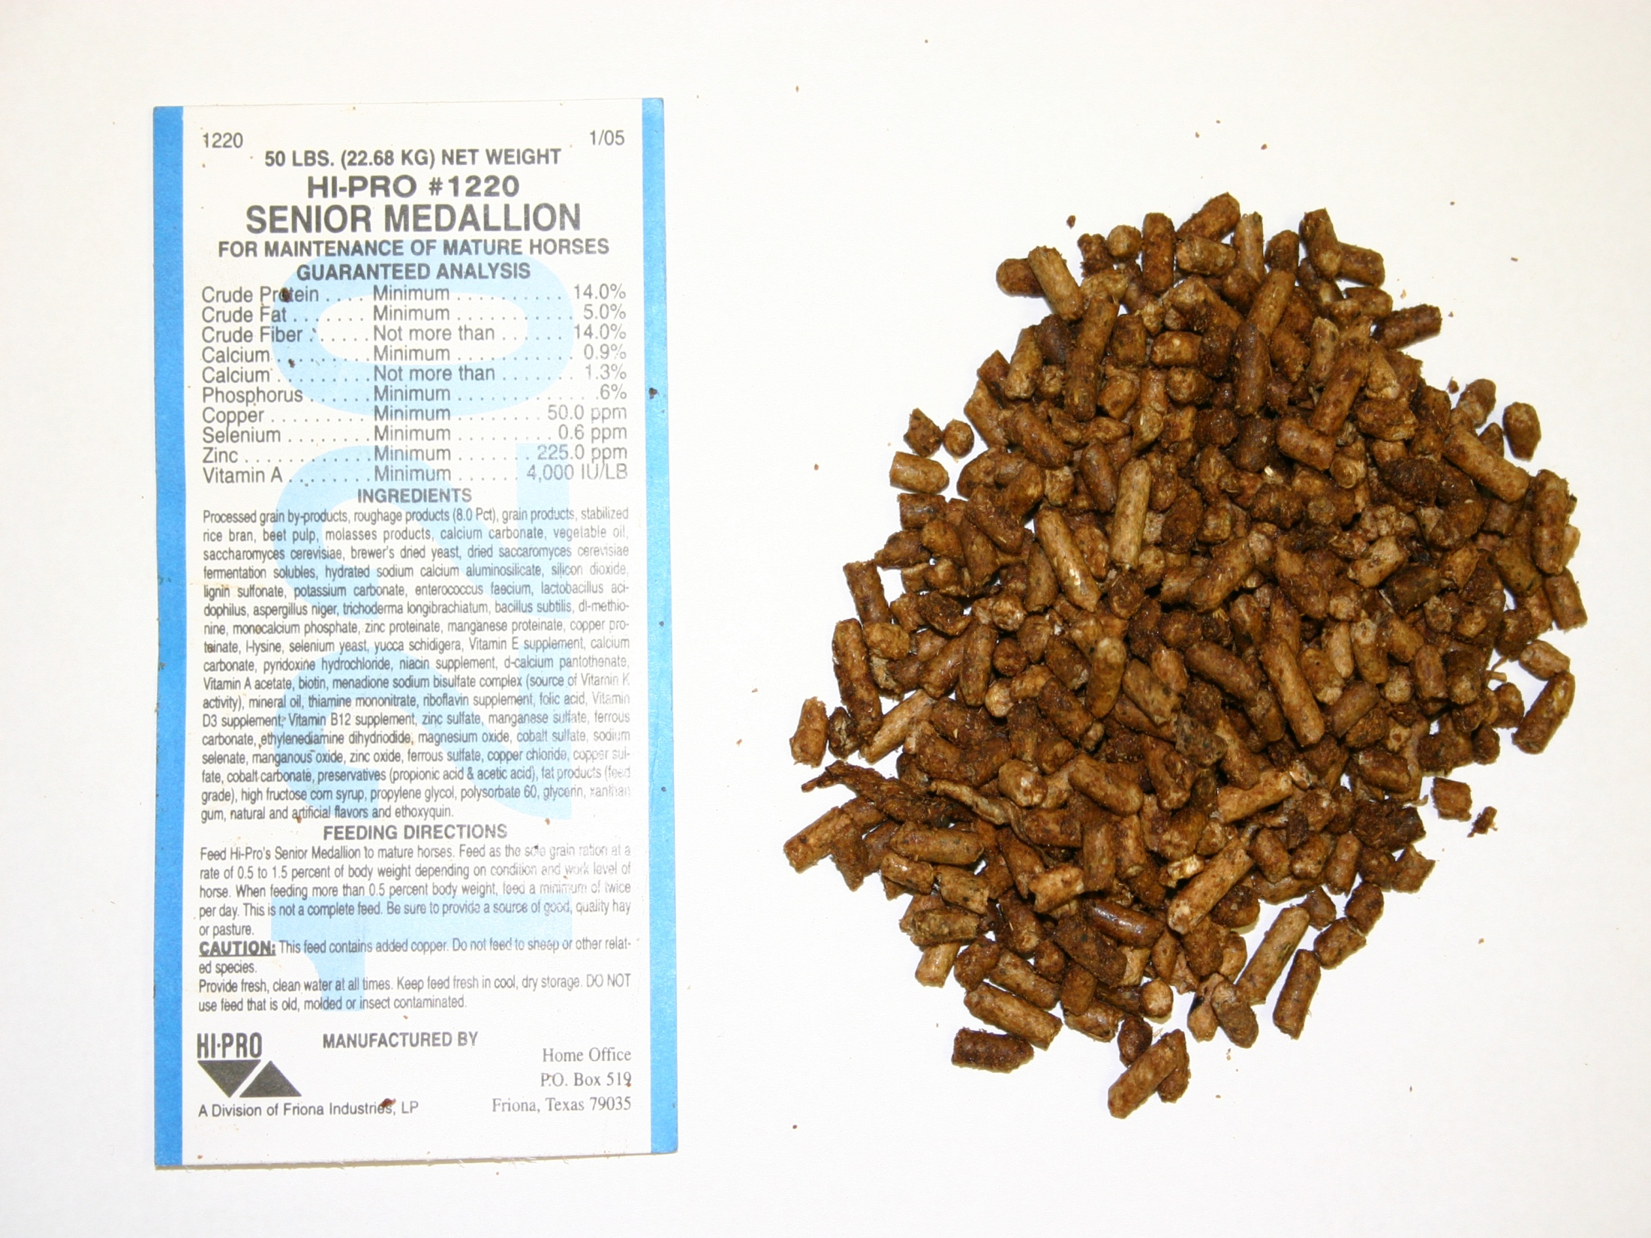

Slide 41
