Slide 1
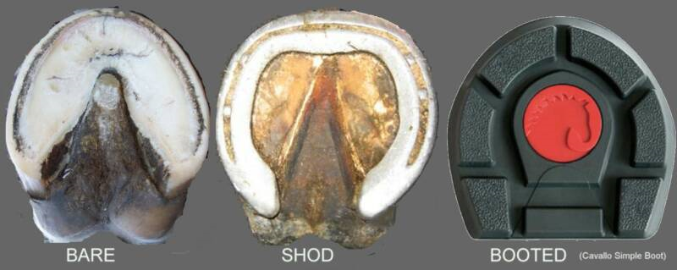
Hoof Health & Care
AGR 364

Slide 2
Introduction
How long have horseshoes been used on horses?
  ~ 2,000 years
Why do we shoe horses?
  To protect from excessive wear
  Help prevent disease and injury
Neglect may lead to many problems and unsoundness

Slide 3
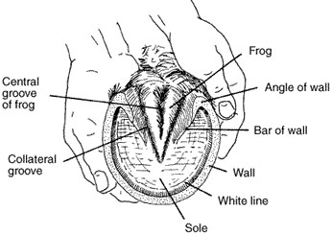
Anatomy

Slide 4
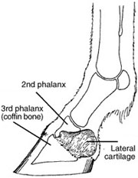
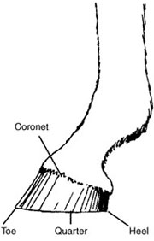
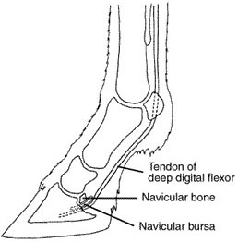
Anatomy

Slide 5
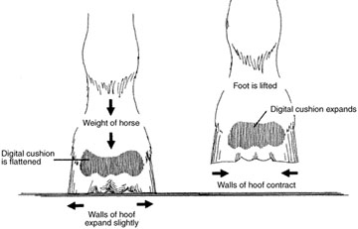
Anatomy

Slide 6
Structure & Function
“No foot, no horse”
  Feet are the foundation of the horse
What are hooves designed for?
  Support Weight
  Replenish Itself
  Absorb Shock
  Provide Traction
  Conduct Moisture
  Assist in Pumping Blood

Slide 7
Structure & Function
Conformation of the horse greatly affects?
  Foot function
The small bones in the foot must be:
  Light enough to:
    Allow the horse to move without fatigue
  Strong enough to:
    Resist shock and compression of weight-bearing

Slide 8
Structure & Function
How does the foot aid in concussion?
  Acts as an overall shock-absorbing mechanism
What affects the amount of concussion?
  Angle of shoulder and pastern
  Elasticity of the lower leg ligaments
  Elasticity and movement of hoof wall

Slide 9
Structure & Function
Why is it important that the hoof is proportional to the horse’s body size?
  Ideal distribution of body weight over the foot’s laminar surface
  So hoof can expand normally during movement

Slide 10
Structure & Function
Hoof size is apparently highly heritable:
  Correlates with bone growth
  Some breeds select for small feet for aesthetic purposes
  Also influenced by nutrition

Slide 11
Structure & Function
Horses that are fed an optimum diet have
  80% increase in hoof-sole border area compared to those fed a limited diet
Optimum nutrition encourages:
  Maximum bone and hoof size development
Different parts of the hoof contain
  Different levels of minerals
  May contribute to strength

Slide 12
Structure & Function
What minerals are found in the hoof?
  Na, K, Zn, Mg, Ca
Older horses tend to have less Na but more K
Wall is higher in Zn than other parts
Frog is higher in K, Mg, and Ca; lower in Zn
Vitamin A is essential for normal hoof growth
  Deficiencies lead to poor hoof walls

Slide 13
Structure & Function
How do hooves resist wear?
  By the integrity and strength of the hoof tubules
    Spiral columnar structures
    Help resist compression and flexion
Wall structure acts like a
  Coil-spring in resisting vertical compression
  Leaf spring in resisting horizontal flexion

Slide 14
Structure & Function
Hoof can be divided into two areas
  Sensitive
  Insensitive
Sensitive areas provide:
  Nourishment and promote growth
  Contain blood vessels and nerve endings
Incentive areas provide:
  Support
  Protection

Slide 15
Hoof Color
Are black hooves are harder than white hooves?
  No
  Hoof compression studies have shown that color does not influence strength
However, in some breeds (Tobiano, Pinto)
  White hooves seems to be of poorer quality
Poor hooves should be protected by shoes

Slide 16
Laminae
Insensitive (Horny) vs. Sensitive
How are laminae associated with concussion?
  Redirect the forces acting upon the foot
  Dissipate concussion
    Coming up from the ground
    Down from the body
  Increase the surface area as much as 30 times

Slide 17
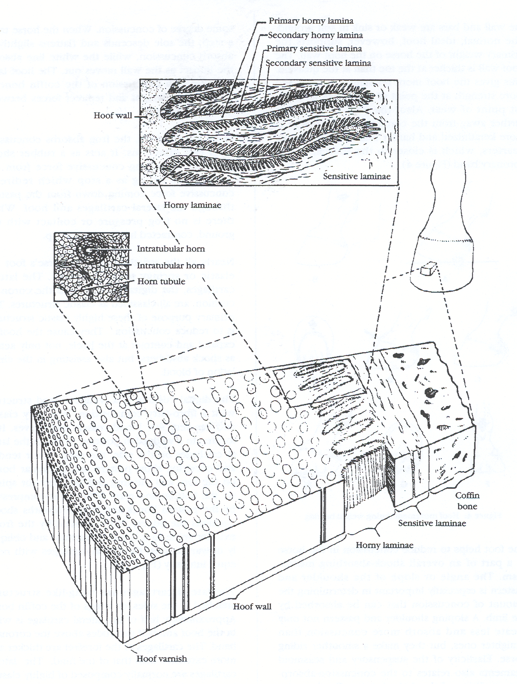

Slide 18
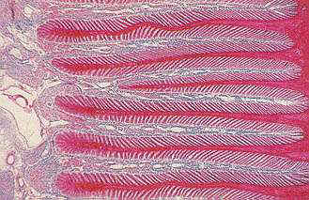
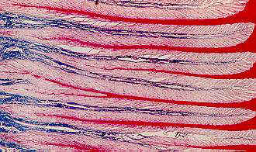
Laminae

Slide 19
Sole
Primary function?
  Protection
Normally arched and can support some weight
Frog can support weight at the heels if the wall and bars are weak
Hoof wall should support the primary weight

Slide 20
Shock Absorption
When the horse takes a step:
  The sole descends and flattens slightly
  White line absorbs impact as the wall moves out
  Laminae diminishes concussion coffin bone
    Transfers weight and redirects forces between hoof and skeleton

Slide 21
Hoof Movement
Must be accommodated by:
  Trimming
  Shoeing
Hoof functions in a:
  Non-slipping manner
  Cutting into ground as it breaks over

Slide 22
Hoof Movement
Are front hooves shaped differently than hind?
Wide front hooves. Why?
  Provide lateral stability
Narrow hind hooves. Why?
  Allow for maneuverability when making sharp turns
Shoeing improves traction on soft ground

Slide 23
Blood Flow
Arteries vs. Capillaries vs. Veins
What is blood necessary for?
  Growth
  Normal function
  Repair of tissue
How many muscles in the lower leg?
  None
  Other mechanisms needed to return blood back to heart

Slide 24
Blood Flow
Within the foot are:
  Large venus plexuses
  Made up of extensive network of veins
Compression of these veins
  Forces the blood back up leg
How is blood prevented from returning to the foot?
  Valves in the veins of the leg

Slide 25
Blood Flow
Each time the foot bears weight:
  Veins are compressed
Each time the foot is raised:
  Veins open and blood is pushed back into foot
Arteries in the foot have a pulse
  Can be easily felt by
  Lightly pressing the artery against sesamoid bone

Slide 26
Blood Flow
A stronger than usual pulse may indicate what?
  Inflammation
Shunts
  Alternate Pathways
  Exist between arteries and veins
    Bypass capillaries in lower leg

Slide 27
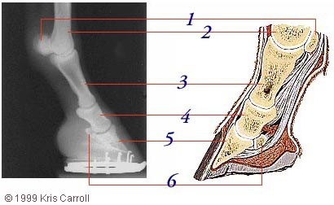
Blood Flow
When do shunts open?
  During times of stress
Shunt function may lead to what?
  Laminitis and/or Founder

Slide 28
Rate of Growth
Rapidly growing hoofs are usually of higher quality and easier to keep
Many factors effect hoof growth
  Young vs. Old
  Warm vs. Cold
  Irritation vs. Normal
  Front vs. Hind
  Increased Exercise vs. Idle
  Ad Libitum Feeding vs. Limited Intake

Slide 29
Rate of Growth
Also seems to be highly correlated to:
  Heart rate
Foals have a heart rate:
  At least twice-as-fast as older animals
Rate decreases with age
Average growth rate of hoof is about?
  3/8 inch/month

Slide 30
Rate of Growth
Why may hooves grow uneven?
  Unequal weight distribution
    May cause flaring or cracks
How often should trimming occur?
  Every 4-6 weeks typically

Slide 31
Rate of Growth
Many feed additives on market for hooves
  Little improvement has been shown
  Unless poor nutrition is present
Feed Additives include:
  Biotin
  Methionine
  Omega 3 fatty acids
  Etc.

Slide 32
Hoof Moisture
Does Moisture effect hoof quality?
  Absolutely - Directly
  Constant evaporation taking place
  Too much water
    May create weak hooves
  Too little water
    may cause hooves to become brittle and break off

Slide 33
Hoof Moisture
Water Content of Hoof:
  Wall
    25%
  Sole
    33%
  Frog
    50%

Slide 34
Foot Care Guidelines
Foot problems cause
  Majority of lameness
What has the greatest effect on pre-disposition to foot disease?
  Hoof Conformation
  Body Conformation

Slide 35
Foot Care Guidelines
Do all horses need to be shod?
Some are left unshod when not being used
Hooves will stay short by
  Natural wear in rocky terrain

Slide 36
Shoeing
Shoes should be applied with:
  Nails in the front half of the foot
  Should be long enough to give support to heel
Shoes should provide
  Some degree of traction and protection to sole
Clips may also be used to secure shoes
Hot fitting may also increase fit of shoes

Slide 37
Common Foot Problems
Foot Disease may cause:
  Severe Lameness
  May be worse by owner neglect
Diseases may occur even under
  Optimum conditions

Slide 38
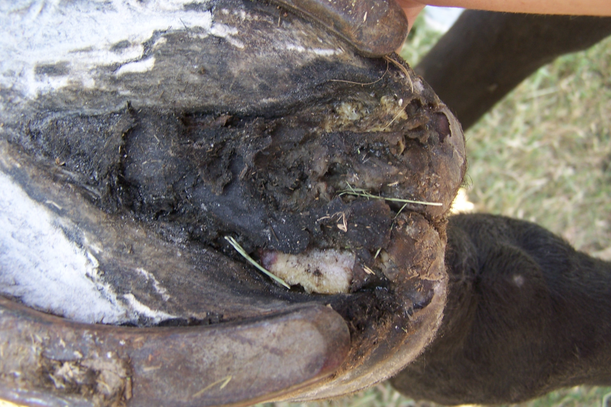
Common Foot Problems
Thrush:
  Destruction of the frog by anaerobic bacteria
  Usually black and strong smelling
  Commonly found in the sulcus
  If severe enough, could lead to an abscess

Slide 39
Common Foot Problems
Thrush:
  Usually caused by:
    Unclean, dirty conditions
    Combined with long untrimmed hooves
  Most infections are stopped by:
    Removing affected tissue
    Cleaning foot daily
    Applying antiseptic drying agent

Slide 40
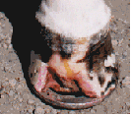
Common Foot Problems
White Line Disease:
  A fungal infection of the hoof wall
  Wall must be removed and treated with strong fungicide
  Common in humid areas

Slide 41
Common Foot Problems
Sole Bruises:
  Caused by concussion of the sole
  Caused by rocks, gravel, and hard objects
  Un-level horseshoe may also cause problem
  Once bruised, pads may need to be applied

Slide 42
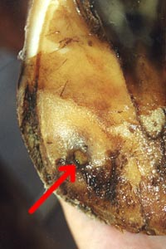
Common Foot Problems
Abscess:
  Pus pocket or infection of sensitive structures
  Most commonly occurs in sole or the white line area
  Follows the path of least resistance until it breaks out and drains
  May result from puncture wounds, thrush, sole bruises, or laminitis
  Tetanus vaccinations are important

Slide 43
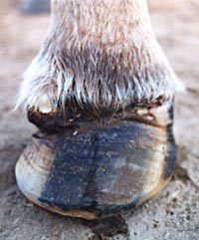
Common Foot Problems
Abscess:
  Must be opened to allow to drain
  Soaking in Epsom salt helps promote drainage
  Germicide should be applied
  Should also be packed to promote drainage
  Pads applied
  Can cause intense pain and severe lameness

Slide 44
Common Foot Problems
Sand Crack:
  Often called a toe crack or quarter crack
  May be superficial or deep and serious
  May result from:
    Uneven weight bearing
    Irregular hoof growth
    Wire Cuts
    Excessive hoof length
    Dry Conditions

Slide 45

Common Foot Problems
Navicular Disease:
  Pain in the area of the Navicular Bone
  May involve:
    Inflamation of the Navicular bursa
    Ligament Sprains
    Cartilage or Tendon Destruction
    Bone Changes
    Pain may be mild or severe

Slide 46
Common Foot Problems
Navicular Bone Function:
  Redirects the pull of the deep flexor tendon against the coffin bone as the horse moves forward
  The navicular bursa is a fluid-filled sack that lubricates the tendon surface of the navicular bone

Slide 47
Common Foot Problems
Navicular Bone:
  Held in place by two ligaments
  Ligaments provide blood supply and nourishment
  If injury occurs, blood supply may be affected and lameness may occur

Slide 48
Common Foot Problems
Signs of Navicular Disease:
  Pointing of toe with heel off the ground
  Short Steps
  Contracted Heels
Treatment:
  Bar shoes with heel support
  Medication to improve circulation
  Nerve operations (last resort)

Slide 49
Common Foot Problems
Laminitis or Founder:
  Disturbance in the circulation of the laminae
  Inflammation of laminae
    Possible separation
    Rotation of coffin bone

Slide 50
Common Foot Problems
Causes of Acute Laminitis:
  Over feeding or sudden changes in feeding
  Colic
  Excess water consumption when hot
  Excessive foot concussion or fatigue
  Retained placenta
  Infections or poisons
  Drug abuse
  Allergies

Slide 51
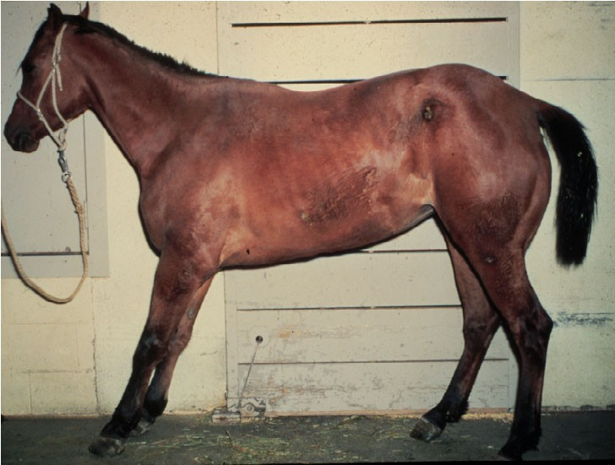
Common Foot Problems
Signs of Acute Laminitis:
  Heat in the foot
  Stronger than Normal Digital Pulse
  Characteristic Stance

Slide 52
Common Foot Problems
Treatment of Acute Laminitis:
  Difficult and often disappointing
  Coffin Bone must be stabilized
  Abscesses must be drained
  Part of hoof wall may need to be removed
  May require as much as a year of daily treatment
  Many never recover

Slide 53
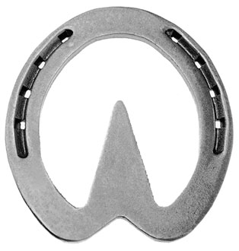
Common Foot Problems
Treatment of Acute Laminitis :
  Heart bar shoes may be applied to provide support
  Drugs used to deaden pain & improve circulation
  Heel elevation

Slide 54
Common Foot Problems
Chronic Laminitis:
  Lingering lameness
  Can be detected by:
    Irregular rings in hoof wall
    Wider at the heel than at the toe
  Wide white line at the toe and a flat sole
  Good management is the best treatment
  Sometimes foot disease is unavoidable

Slide 55
What Happens During Laminitis?
Endotoxemia occurs
Blood concentration lactic acid increases
Histamine formation & blood platelet function impaired
Shunts Open
Necrosis of laminae
Possible rotation of coffin bone

Slide 56
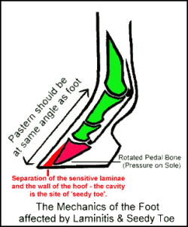
Laminitis or Founder

