Slide 1
Identification & Breeds
Lecture 4

Slide 2
Horse Identification
Stallion or Stud?
Gelding
Mare
Colt
Filly
Weanling
Yearling
Foal

Slide 3
Donkeys and Mules
Intact male donkey?
Jack
Female donkey?
Jenny
Male donkey bred to female horse?
Mule
Male horse bred to female donkey?
Hinny

Slide 4
Mule
Male Mule
Mule
Gelded Mule?
John Mule
Female Mule?
Molly

Slide 5
Mules
Generally infertile?
Number of chromosomes
Horse 64
Donkey 62
Mule and Hinny 63
Light
Medium
Heavy weight

Slide 6
Mules
Some say
More patient
Sure-footed
Hardy
Outlive horses
No offspring from male mule
Female mules on rare occasion have given birth

Slide 7
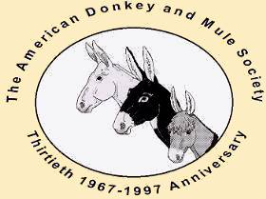
American Donkey and Mule Society
Lewisville, TX
Established 1967
Donkeys
Mules
Zebra hybrids
Miniature to Mammoth
Zorse
Zedonk

Slide 8
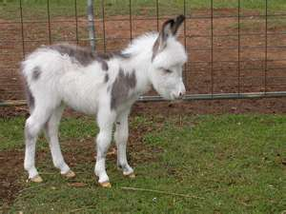
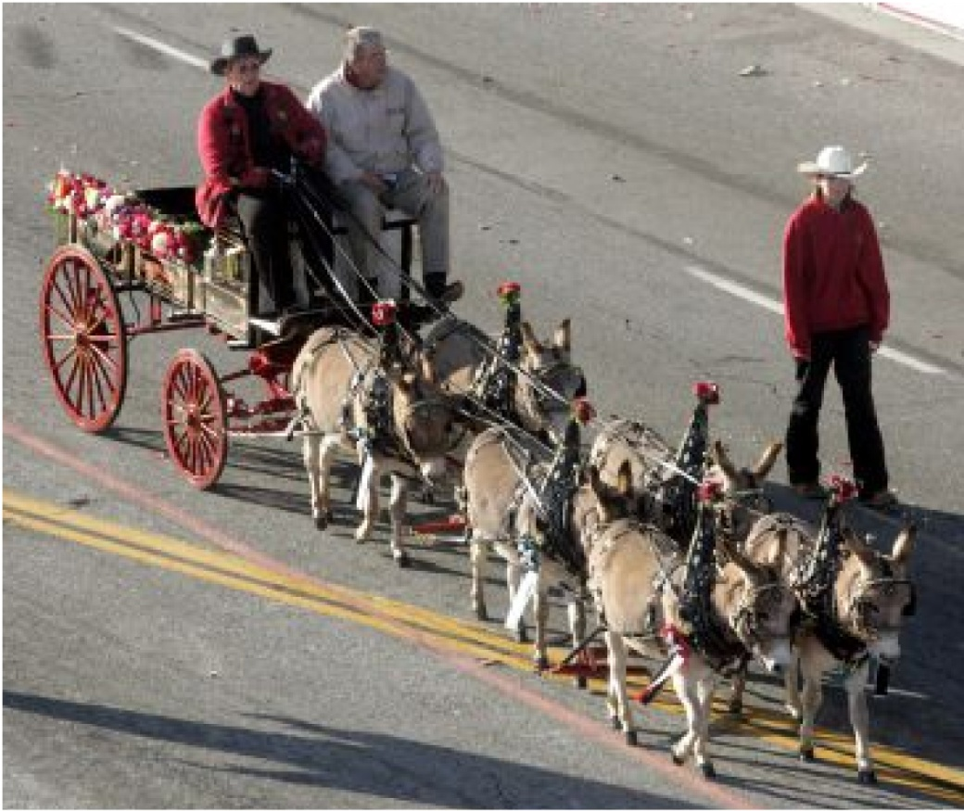
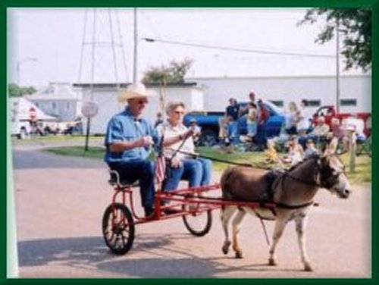
Miniature Donkeys

Slide 9
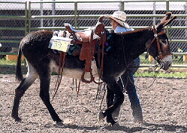
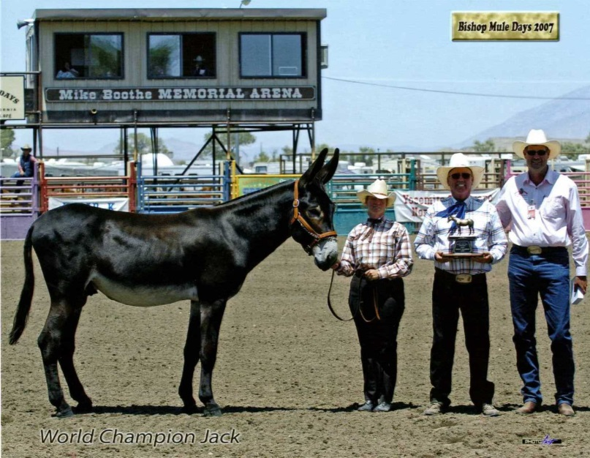
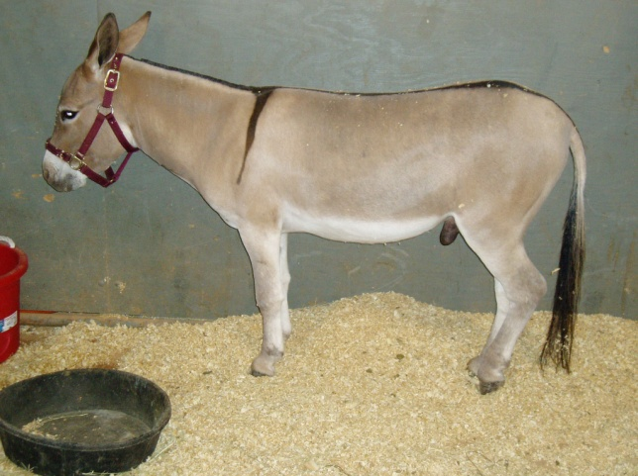
Donkeys

Slide 10
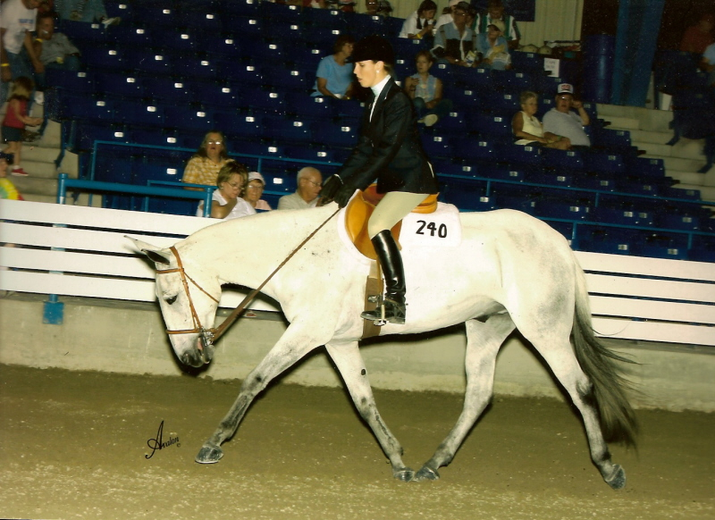
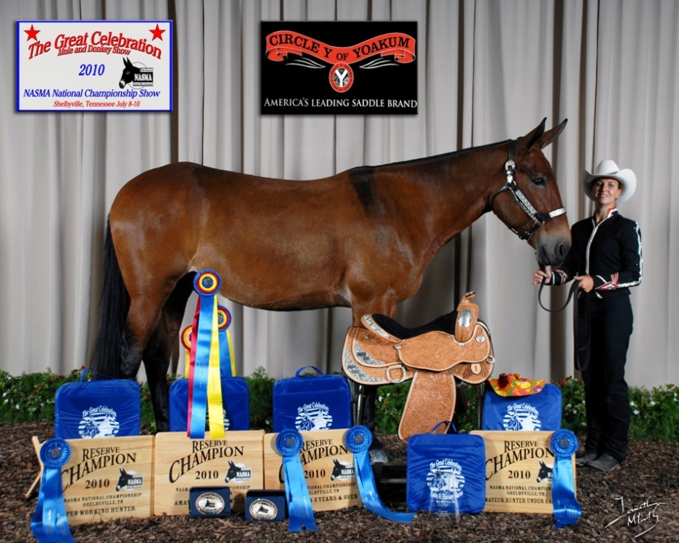
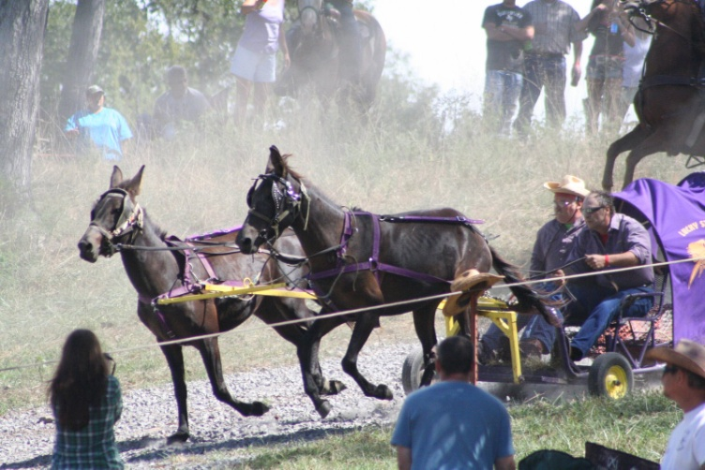
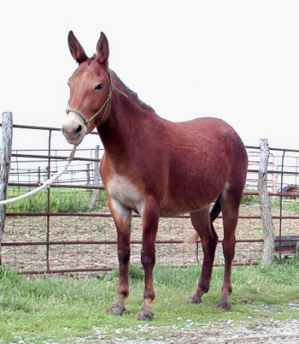
Mules

Slide 11
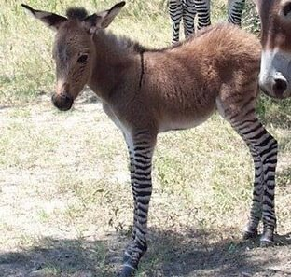
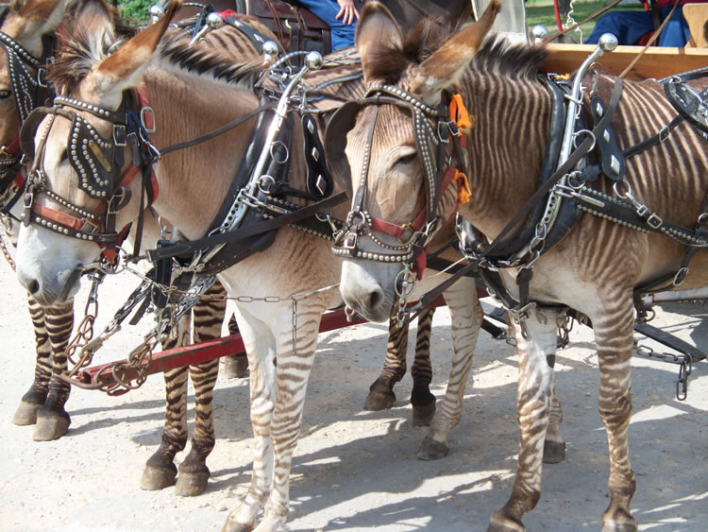
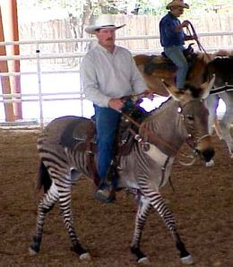
Zedonks

Slide 12
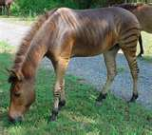
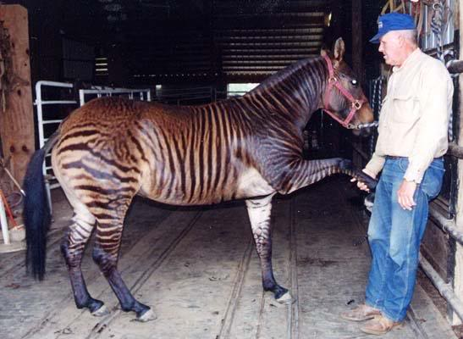
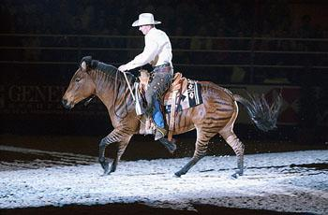
Zorses

Slide 13
Light Horse Breeds

Slide 14
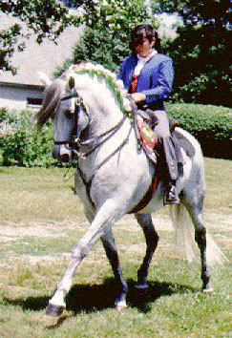
Andalusian
Highly regarded
Since the Middle Ages
Known as
Purebred Spanish Horse
~80,000 in U.S.

Slide 15
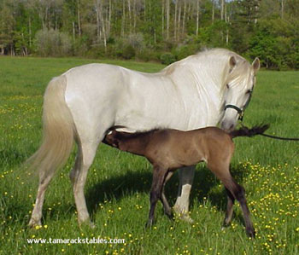
Andalusian
White and light gray
Occasionally bay
Renowned for
Ability to learn
Superb temperament

Slide 16
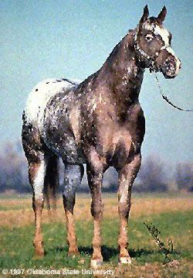
Appaloosa
Nez Perce
First tribe to breed
Washington, Oregon and Idaho
International breed registry
ApHC
Located in
Moscow, Idaho

Slide 17
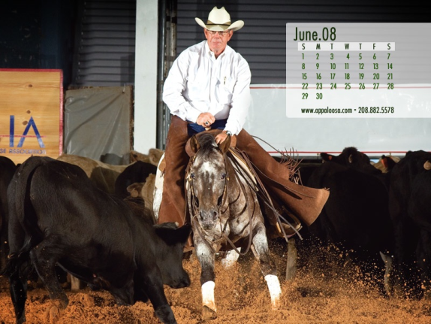
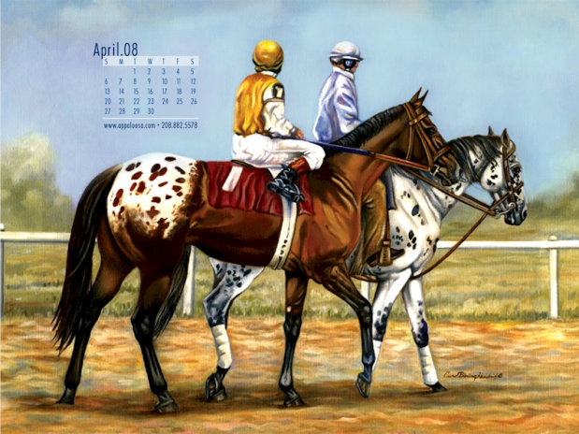
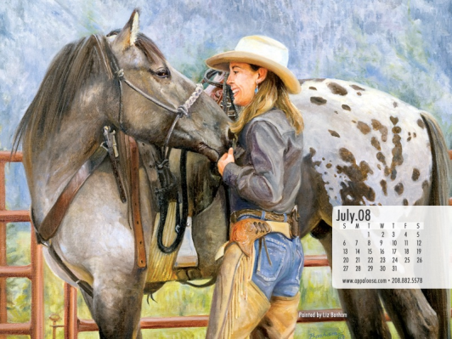
Appaloosa
How many on record?
~500,000
Common coat colors?
Leopard
Blanket

Slide 18
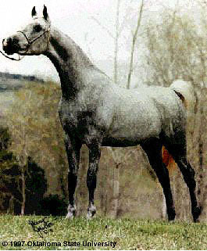
Arabian
Bred for endurance in desert
Egyptian and Polish
Arabians genetics in
All breeds of light horses
What are main characteristics?
Head
Prominent Eye

Slide 19
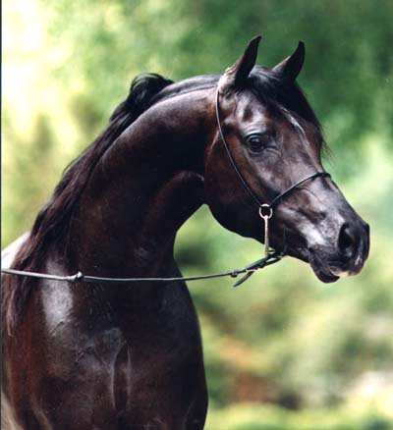
Arabian
Swan like neck
Flat back and croup
High tail carriage
Colors?
Gray, Chestnut, Bay and Roan
Occasional Solid Black
14.2 and 15.2 hands
Weigh ~800 and 1,000 pounds

Slide 20
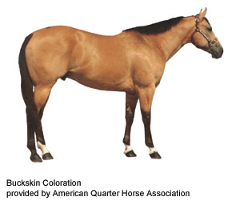
Buckskin
Originated from
Spanish Sorraia
International Buckskin Horse Assoc
American Buckskin Registry Assoc
Registry claims
Stamina
Determination
Harder feet, better bone
Generally hardier than other horses

Slide 21
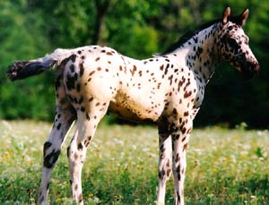
Colorado Ranger Horse
Not a type of Appaloosa
Can be double registered
Bred for
Cow savvy
Performance
No color preference
Some colored
Some are not

Slide 22
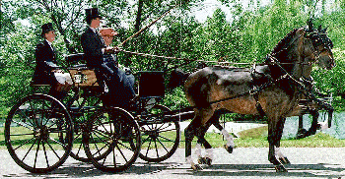
Hackney
Responsible for improvement in
Quality of life
Public roadways in Britain
Swift trotting horse

Slide 23
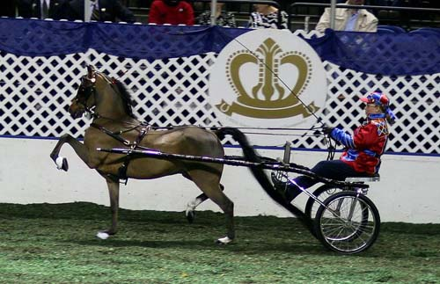
Hackney
Considered
Ultimate Driving Machine of 1880s
America and in Britain
Hackney Stud Book Society
England 1883

Slide 24
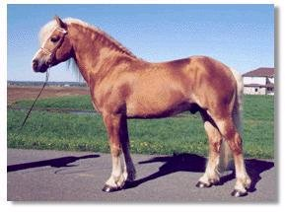
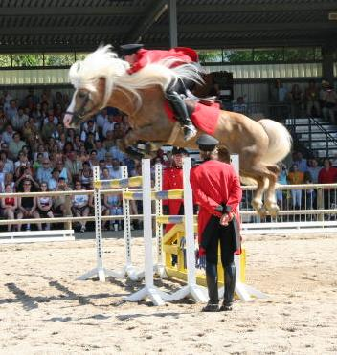
Haflinger
Developed
Austria and Northern Italy
Known for handling rough terrain
American Haflinger Registry
1998
Pale chestnut to dark chestnut
Pale mane and tail

Slide 25
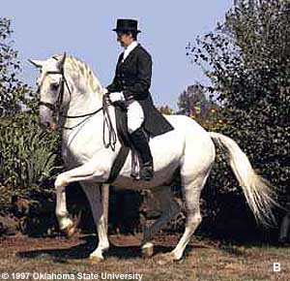
Lipizzan or Lipizzaner
Breeding dates back to
Early 1560's
Spanish Riding School
Dominate color?
Gray
Noted for
Sturdy body
Brilliant action
Proud carriage
Intelligent and docile disposition

Slide 26
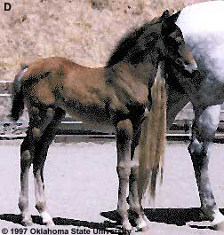
Lipizzan or Lipizzaner
Born
Black-brown
Brown or mouse-grey
Turn white
Between the ages of 6 and 10
Averaging height?
14.3 to 15.3 hands

Slide 27
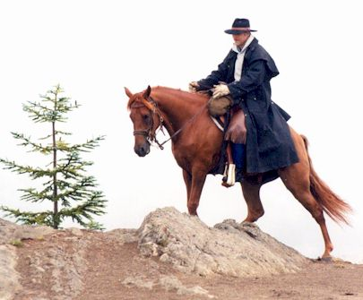
Missouri Fox Trotter
Developed in
Ozarks
19th century
Considered
Easy riding, durable
Travel long distances
Sure-footed

Slide 28
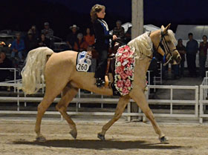
Missouri Fox Trotter
Distinguishing characteristic
Fox trot gait
Walks with the front feet
Trots with the hind feet

Slide 29
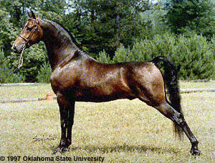
Morgan
Justin Morgan
School teacher
Owned the first Morgan
Breeding was unknown
14.2-15.2 hands

Slide 30
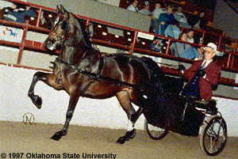
Morgan
Color?
Chestnut
Bay
Brown
Less Prominent:
Black
Palomino
Buckskin
Few grays

Slide 31
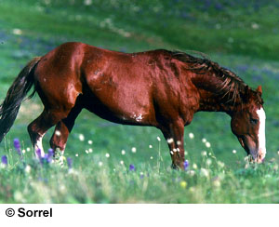
Mustang
Feral horse
Western U.S.
Derived from?
Spanish horses
Changed lives of
Native Americans

Slide 32
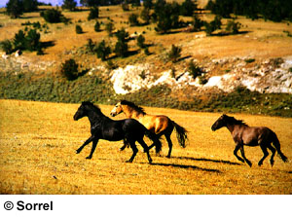
Mustang
Population began in
20th century
~ 2 million
Current population
~ 30,000

Slide 33
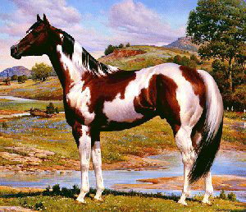
Paint
Stock-type conformation
Natural intelligence
Willing disposition
In past
AQHA crop outs
Current
One paint parent
Also have one
QH or Thoroughbred parent

Slide 34
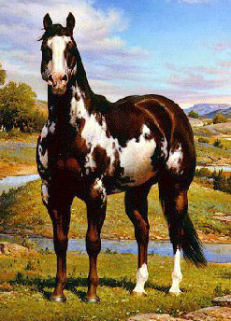
Paint
Colors Patterns?
Overo
Tobiano
Tovero
Not to be confused with Pinto
Double registry is possible

Slide 35
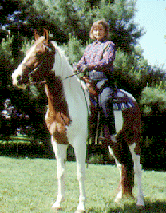
Pinto
Color Breed
Not a stock Breed
Does not require genetic ancestry
Does not accept horses with
Appaloosa
Draft
Mule breeding

Slide 36
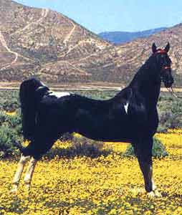
Pinto
Does not have consistent
Conformation
Bred for color
Four types of conformation:
Saddle type
Stock type
Hunter type
Racing type

Slide 37
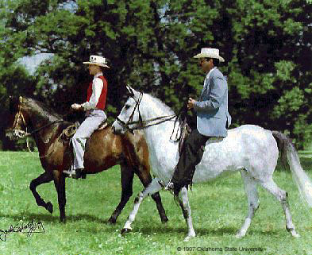
Paso Fino
Spanish Heritage
Lateral four-beat gait
Basic gaits in order of speed are the
Paso fino
Paso corto
Paso largo
Makes for a very smooth ride
Also trot and canter

Slide 38
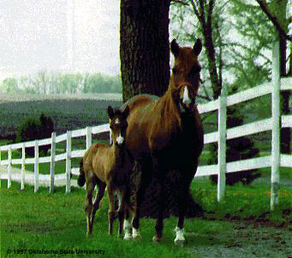
Paso Fino
13.2 hands to 15.2 hands
Chestnut
Bay
Palomino
Black
Grey
Roan
Pinto
Ridden and trained
English and Western

Slide 39
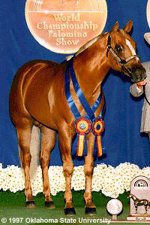
Palomino
Palomino Horse Breeders of America
Color registry for horses
Standing between
14 & 17 hands
Exhibiting body color
Variations from light to dark

Slide 40
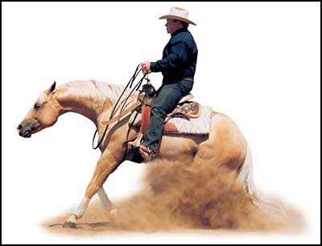
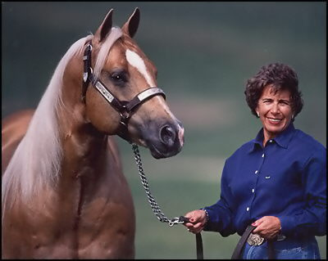
Palomino
Three Divisions:
Stock Type
Saddlebred Type
Pleasure Type
May also be registered
Morgan
Quarter
Saddlebred
Arabian
Jockey Club
Tennessee Walking Horse

Slide 41
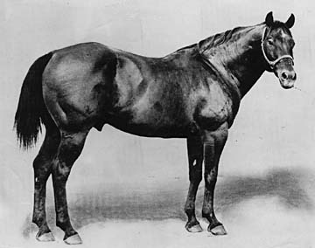
Quarter Horse
Named for what?
Speed at the quarter mile
Quick to start, easy to handle
Good Temperament
Cow sense
First registered QH was
Wimpy
Won Fort Worth Stock Show 1941
Owned by King Ranch

Slide 42
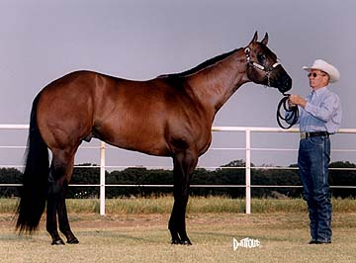
Quarter Horse
Very versatile breed
Originated from
Arab, Turk and Barb breeds
Thoroughbred was a major influence
Must have verification of
Parentage

Slide 43
Racking Horse
Known for:
Beauty and Stamina
Calm disposition
Smooth easy lateral gait
Walking horse blood lines
Rack
Walk Hind
Trot Front
Hooves hit ground 1 at a time

Slide 44
Saddlebred
First mentioned in U.S.
1776
Successful as
Cow horses to jumpers
Dressage to carriage horses
Display a large amount of
Animation in their travel

Slide 45
Standardbred
Fastest harness horse in world
Foundation sire?
Hambletonian 10
Average 15.2
Weighing 800-1000 lbs
Trotters and Pacers

Slide 46
Tennessee Walking Horse
Breed developed from:
Standardbreds
Morgans
Thoroughbred
Narrangansett Pacers
Prominent characteristic
Smooth running walk

Slide 47
Tennessee Walking Horse
Also known for
Flat foot walk and canter
All gaits very smooth
Very popular with
Southern plantation owners

Slide 48
Thoroughbred
Traces back to three foundation sires:
Darley Arabian
Godolphin Arabian
Byerly Turk

Slide 49
Thoroughbred
The Jockey Club
Records of Racing
Dates back to
Long Island in 1665
Travel
35-40 mph
Will not allow A.I.

Slide 50
Warmbloods

Slide 51
Dutch Warmblood
Dressage
Jumping
3-day event
Driving
Known for
Temperament
Adaptability
Soundness

Slide 52
Hanovarian
Noble, balanced horse with
Impulsion
Elegant
Elastic movements
Home is in Lower Saxony in Northern Germany
Formerly Kingdom of Hanover
Breeding for over 400 years

Slide 53
Holsteiner
Breeding in Germany for 750 yrs
One of Greatest German Sporting Horses
Jumping
Dressage
Driving
Eventing
Stands 16-17 hands

Slide 54
Swedish Warmblood
Breeding linked to
Thoroughbred
Fresian
Hanovarian
Trakehner
Known for
Elegance
Jumping ability
Ability to absorb intense training
Medalists in every Olympiad since 1912
Most often in Dressage

Slide 55
Trakehner
East Prussian origin
1732
Trakehnen, East Prussia
Stands 16-17 hands
Thoroughbred and Arabian blood later introduced
Excels in
Dressage and jumping
Excellent temperament

Slide 56
Draft Horses

Slide 57
Belgian
Carried knights into battle
Provided genetic material
All the modern day draft breeds

Slide 58
Clydesdale
Developed and derived from Scotland
Feathers
Commonly :
Bay
Black
Brown
Chestnut
Roan

Slide 59
Friesian
One of oldest
Domesticated breeds in Europe
Native to
Friesland
Northern Netherlands
Traditionally used
Harness

Slide 60
Friesian
Also found
Circuses
Driving competitions
Very long mane and tail
Feathers
Always black
Only white star on forehead is permissible

Slide 61
Percheron
Le Perch mares
Mated to Arab stallions
France
Black or gray

Slide 62
Shire
Origin has been lost
Thought to have originated in England
War Horse
Strength
Courage
Aptitude
Very large breed

Slide 63
Ponies

Slide 64
Chincoteague (shinko - teeg) Pony
Descend from
Wild horses on Assateague island
Off the coast of Maryland
Thought to have been
brought over in the 17th century
Stand 12-13 hands

Slide 65
Miniatures
Height breed
Must measure no more than 34”
American Miniature Horse Association

Slide 66
Ponies of America (P.O.A.’s)
Founded in 1954 in Iowa
Distinctive breed
Possesses color of Appaloosa
Influence by:
Arab
Thoroughbred
QH
Appaloosa
Welsh and Shetland Pony

Slide 67
Shetland
Possible, oldest breed in Britain
Named after island of origin
Stands on ~9.3 to 10.2 hands

Slide 68
Welsh Pony and Cob
Original home
Wales
Under 15 hands
Worked in
Coal mines
Ranches
Postman routes

