Slide 1
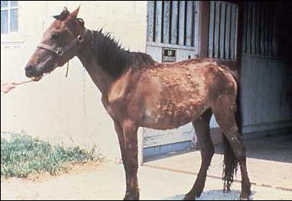
Internal Parasites
Equine Science

Slide 2
Internal Parasites
Why should we be concerned?
  Affects:
    Reproduction
    Growth
    Performance
    Overall well being
How many internal parasites are known to affect horses?
  >150

Slide 3
Internal Parasites
What types of internal parasites are we most concerned with?
  Ascarids
  Strongyles
  Pin Worms
  Bots
  Threadworms
  Tapeworms

Slide 4
Ascarids (Roundworms)
Primarily affects??
  Foals and young horses
Adult parasite may reach
  5 to 22 inches
Immunity develops by exposure during adolescence
Damage begins during migration

Slide 5
Ascarids (Roundworms)
Damage includes:
  Physical damage, inflammation, and scaring of liver and lung tissue
May also cause:
  Digestive irritations
  Decreased feed absorption
  Possibly colic

Slide 6
Ascarids (Roundworms)
Transmission?
  Swallow eggs with feed, pasture, or water
  Eggs hatch and larvae burrow into S.I.
  Travel to liver, heart, and lungs
  Migrate via blood supply from lung tissue to air spaces
  Coughed up, re-swallowed, return to S.I. and mature

Slide 7
Ascarids (Roundworms)
3 months to complete life cycle
Eggs will start appearing in manure
  10-13 wks old
Female worm will lay up to
  200,000 eggs/d
  Larva develops in ~2 wks
Eggs are very resilient and may remain infective for years in pastures or stalls

Slide 8
Ascarids (Roundworms)
Typically passed from one foal crop to another
Prevention requires
  de-worming at least every two months through the first year of life
Some foals will cough and nasal discharge (no response antibiotics)

Slide 9
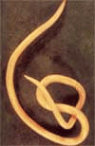
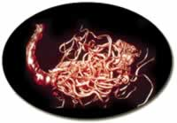
Ascarids (Roundworms)
Signs include un-thriftiness, pot belly, rough hair coat, slow growth, and depression

Slide 10
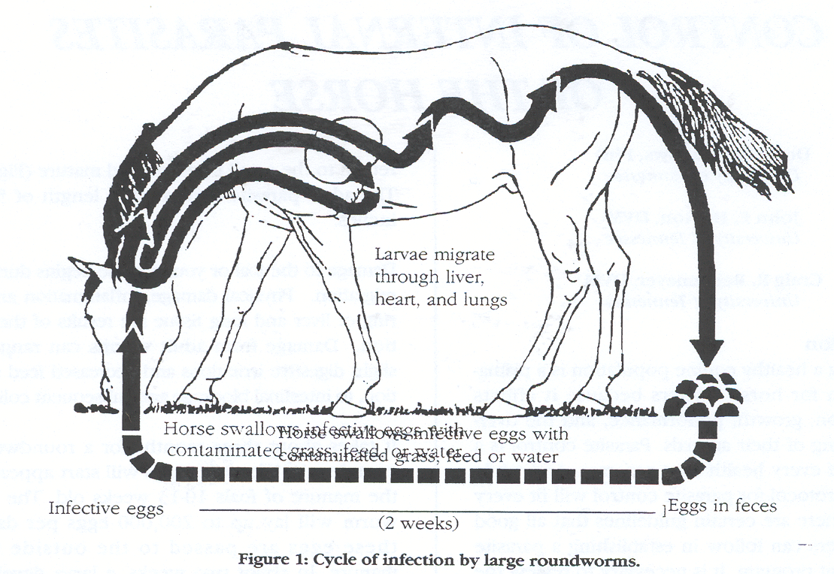

Slide 11
Strongyles
Most significant and most common
Occur in what ages?
    All ages; except neonatal foal
Sexually mature strongyles are found
  Within the L.I.
Commonly divided into two groups
  Large and Small

Slide 12
Strongyles
Majority of larvae occur on pasture vegetation
  Little transmission indoors
Extremely resistant to adverse weather conditions
Survive freezing winters easily; however
  Killed by hot, dry summer conditions
Once ingested
  Enter the lining of the S.I., cecum ,and L.I.

Slide 13
Large Strongyles
Three significant species:
  Strongylus vulgaris (bloodworms)
    Larvae burrow into small arteries in the gut wall and migrate to the anterior mesenteric artery
      Main blood supply to digestive tract
Migration causes disruption of blood flow by formation of blood clots in the artery

Slide 14
Large Strongyles
Larvae remain in anterior mesenteric artery
  ~120 days while they grow and develop
Start a return migration
  Down the arteries to the L.I.
Upon maturation
  Females may lay several thousand eggs/d
  Passed into manure
Life cycle takes
  ~6 to 7 mo.

Slide 15
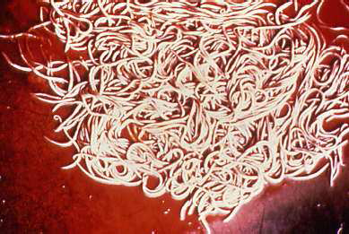
Large Strongyles

Slide 16
Small Strongyles
Strongylus endentatus
Strongylus equinus
  Similar life cycles but not as dangerous
  Migrate within the liver, causing damage, and then return to the L.I.
  8 to 11 month life cycle

Slide 17
Small Strongyles
De-wormers have
  Reduced the significance of these parasites
Migrate beyond the lining of the small intestine
  Tissue damage is somewhat less severe
May cause diarrhea & increased chances of colic

Slide 18
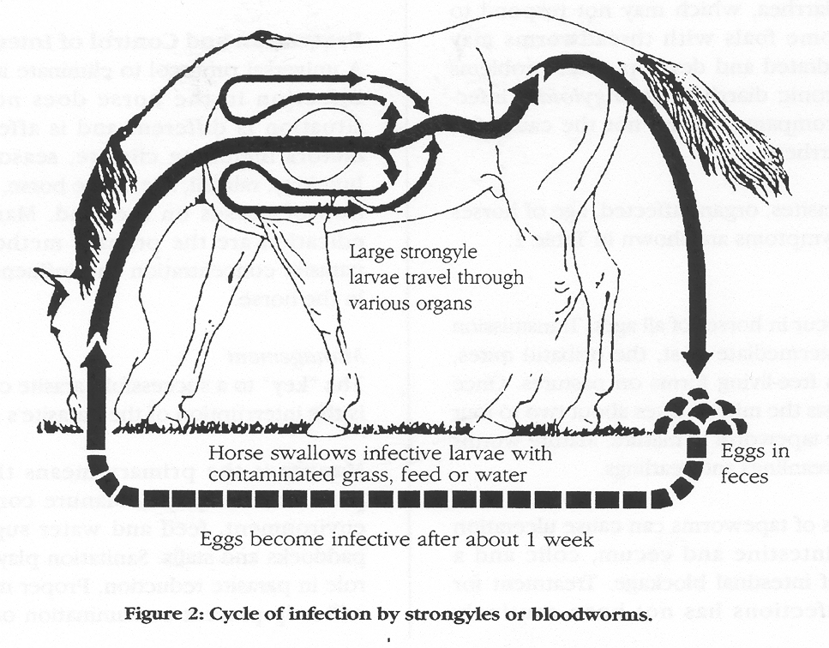

Slide 19
Pinworms
Not very harmful
  Relatively simple life cycle
Adults found primarily in
  Colon and rectum
Lay eggs around anus
  Contaminate pastures, water, bedding, etc.

Slide 20
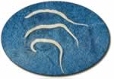
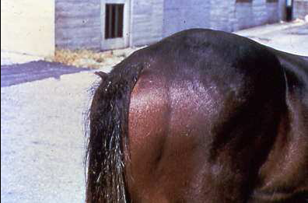
Pinworms
After ingested
  Develop into maturity in the colon and rectum without a migratory state
Damage is minor
Produce severe irritation around the tail
  Causes rubbing

Slide 21
Stomach Bots
Larvae of the Bot Fly
Adult fly resembles a honey bee
Females lay eggs on the hairs of horses, especially legs
Friction and moisture is necessary for hatching

Slide 22
Stomach Bots
Horse licks area where bots are attached
Larvae attach to tongue
  Burrow into the tissue of the mouth
Those attached to neck, mane, and face
  May migrate to mouth

Slide 23
Stomach Bots
After ~ three weeks
  Second stage larvae emerges that is swallowed
  Attaches to the lining of the stomach
Spend ~ 9 months attached to stomach lining
  Then pass out in manure
Pupate into adult flies

Slide 24
Stomach Bots
Life cycle depends on
  The larvae over-wintering in the stomach
Adult flies are active from
  Late spring to the killing frost
Treatment for bots should be scheduled from
  Mid to late summer
  Again after a killing frost

Slide 25
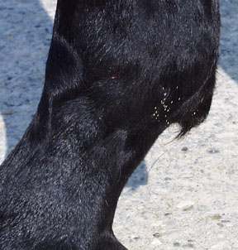
Bot Eggs

Slide 26
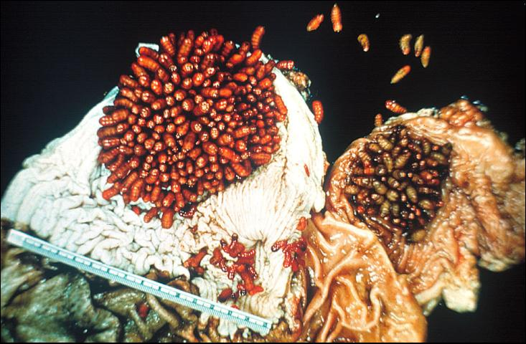
Bot Larvae

Slide 27
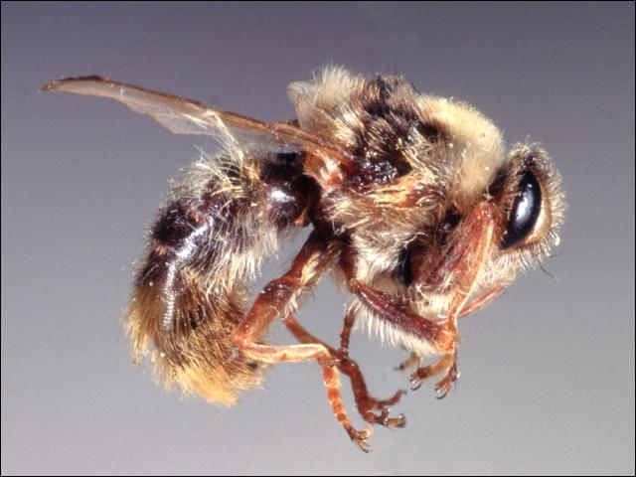
Bot Fly

Slide 28
Strongyloides (Threadworms)
Mainly infects young foals 4-47 d old
Foals become infected by
  Ingesting larvae in the dam’s milk
Larvae migrate through the lungs and S.I.
  Causing injury while passing

Slide 29
Strongyloides (Threadworms)
Life cycle can be completed in
  < two weeks
Creates potential for severe infections in short time intervals
Foals will quickly reject the infection
  by 60 – 90 d of age

Slide 30
Strongyloides (Threadworms)
Main problem is
  Diarrhea, which may not respond to treatment
May become extremely dehydrated
May accompany “foal heat” diarrhea

Slide 31
Tapeworms
Occurs in all ages of horses
An intermediate host (ingestion of mite)
Once ingested
  Takes about two to four months for tapeworm to mature
Mature worms first occur in weanlings and yearlings

Slide 32
Tapeworms
Large number can cause ulceration in L.I. cecum, and colon
May also cause intestinal blockage
Pyrantel pamoate is effective in removing by
  Doubling normal dosage
What is the most common drug for removal
  Praziquantel

Slide 33
Prevention and Control of Internal Parasites
No way to eliminate
Factors affecting internal parasite loads include:
  Season of year
  Humidity
  Rainfall
  Age of Horse
  Concentration of Horses on Land

Slide 34
Prevention and Control of Internal Parasites
Key to successful control program is
  Interruption of the life cycle
What is primary means through which Parasites spread?
  Manure
Manure contaminates
  Feed and water supply, pastures, paddocks, and stalls

Slide 35
Prevention and Control of Internal Parasites
Sanitation plays an important role in
  Parasite reduction
Proper manure disposal will
  Help prevent contamination
Manure should be
  Composted before spreading on pastures currently being grazed

Slide 36
Prevention and Control of Internal Parasites
If manure is not composted
  Should be spread on un-grazed pasture
Good pasture management can
  Dramatically reduce internal parasites
Should prevent overcrowding

Slide 37
Prevention and Control of Internal Parasites
Mowing and harrowing helps
  Break up manure
  Exposes larvae to existing climatic conditions
Should be cautious of mowing and harrowing
  On occupied pastures
Grazing cattle after horses may be beneficial
  Parasites specific to horses do not affect cows

Slide 38
Prevention and Control of Internal Parasites
Separate and feed by
  Class, stage of production, and/or age group
Yearlings should be managed differently than brood mares. Why?
  They are affected by different types of parasites
  Should also be on a different De-worming schedule

Slide 39
Prevention and Control of Internal Parasites
Try not to feed on the ground
Provide hay mangers and feed bunks
Make sure mangers and bunks are cleaned regularly
Make sure water supply is regularly cleaned and free of fecal material

Slide 40
Prevention and Control of Internal Parasites
Many different commercial products are available for parasite control
  Differ in their ability to remove internal parasites
Important to be familiar with
  Anthelmintics and for which parasites are affected
De-wormers alone will not
  Be effective in parasite control if management is poor

Slide 41
Prevention and Control of Internal Parasites
What are the most common physical forms of anthelmintics?
  Paste
  Stomach tube
  Continuous Method
    Consume small daily doses
    Continuous control except for bots

Slide 42
Prevention and Control of Internal Parasites
No schedule fits all horses
Basic guidelines:
  Most veterinarians feel that horses should be de-wormed at least four times/year
  This would include:
    Strongyles, Ascarids, and Pinworms
    Botacide in early spring and late fall
    Foals every 30 to 60 d for first year

Slide 43
Prevention and Control of Internal Parasites
Rotation of de-wormers is also important
Parasites may become resistant to particular classes
Parasite control can help reduce colic and increase performance

Slide 44
