Slide 1
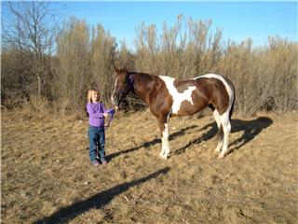
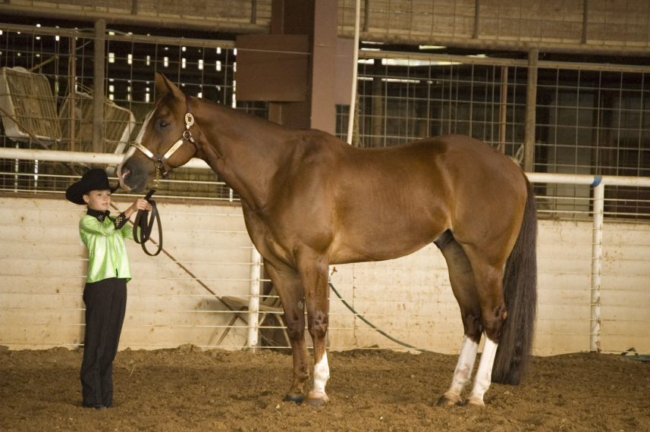
Equine Senses

Slide 2
Physical Parameters
How did horses survive over the years?
  Hiding
  Running away
Tools developed in the past are
  Evident in the reactions of the horse today

Slide 3
Physical Parameters
What are these tools?
      Sight and Skin Sensitivity
      Hearing and Smell
      Reflex for Flight
      Memory and Gregarious Nature
      Ability to feel ground vibrations

Slide 4
Sight
Eyes set wide on head
Monocular vs. Binocular Vision
  Monocular Vision:
  Why was this vision developed?
    To protect from predators
    Allowed to see danger from either side
      Without turning its head

Slide 5
Sight
Binocular Vision:
  Used to judge distances
  Typically not as good as its monocular vision
  Some horses have better binocular vision
    Why?
      Their eyes are set closer together

Slide 6
Sight
Some have to learn to develop binocular vision through training
  Examples:
    Rope horse following cattle at correct distance
    Teaching a barrel horse to judge distance to the barrel
    Teaching a jumper how to approach

Slide 7
Facts About Vision
Blind spots
  Where?
    Directly behind its hindquarters
Can’t see directly below its head
Must lower its head to
  See far away

Slide 8
Facts About Vision
Must raise its head to see?
  Close objects
If object is closer than __, can’t see with its binocular vision
  4 feet
Takes time to adjust eyesight to
  Dark spaces

Slide 9
Facts About Vision
A grazing horse can see?
  Almost all the way around its body
Has a hard time focusing clearly on objects
  Very good at detecting movement

Slide 10
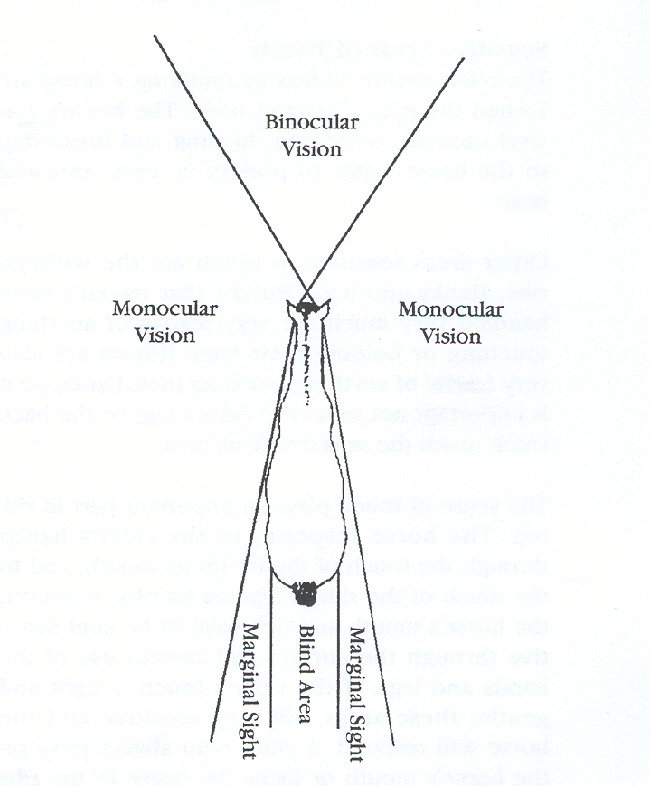

Slide 11
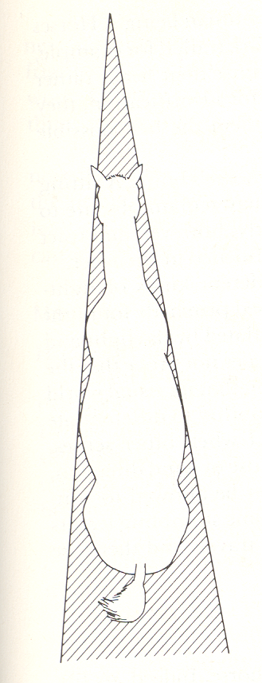
Blind
Spots

Slide 12
Touch
Do horses have a keen sense of touch?
Sense of touch is very important in riding
  Rider’s hands through the touch of the bit
  Rider’s legs on the ribs
  Important that the rider remains soft

Slide 13
Touch
Where are the most sensitive areas?
  Eyes, ears, and nose
  Withers, ribs, flanks, and legs
Fearful of anything touching flanks

Slide 14
Hearing
Do horses have a good sense of hearing?
  Excellent
Much better than sight
  Eyes and ears are always working together
First ears will point toward the sound then
  Horse will try to see what it is

Slide 15
Smell
Sense of smell?
  Good
Stallions can identify mares in heat from great distances
Research trials have found
  Horse can return home from up to five miles when hauled

Slide 16
Smell
Young horses may
  Like to smell saddles
Smell may dictate grazing habits
  Does this prevent consumption of poisonous plants?

Slide 17
Flight Reflex
Quick reflexes and panic
  Characterized the prehistoric horse
Endowed with an extensive system of ligaments which permit them to what?
  Sleep while standing
Will panic into flight without much consideration of such an action

Slide 18
Flight Reflex
Young horse especially will try to flee
As horses get older
  Most tend to become desensitized
Careful management and good horsemanship skills should be used

Slide 19
Memory
Considered to have memories
  Second only to elephants
In wild, if an attack came at a certain place
  The herd avoided that spot in the future
Horses are creatures of habit
  Creatures of laziness?

Slide 20
Memory
Memory and temperament are linked to?
  Breeding
Well-trained horse never forgets its training
  Neither does a poorly trained one
Bad habits should be
  Corrected before they become fixed

Slide 21
Memory
Performance on intelligence tests have
  Not been outstanding
    However, able to complete complex things routinely when trained
What can they not associate with?
  Overeating

Slide 22
Gregarious Nature
Gregarious by nature
  Banding together
Wild horses were safer from attack
Still seen in zebras in Africa
Can be used to the benefit of trainers

