Slide 1
Recognizing the Healthy Horse
AGRI 3364

Slide 2
Introduction
How do we determine our horse is healthy?
  Normal personality?
  Normal behavior?
If abnormal, what should we do?
Should we call the Vet?

Slide 3
Examination
First observation
  How alert?
  Eyes, ears, posture, movement
  Should be continued through observation
Content horses generally display a certain degree of calmness and are alert

Slide 4
Examination
Vital Signs
  Temperature
  Pulse
  Respiration Rate
  Capillary Refill Time
  Mucous Membranes
  Skin Pliability

Slide 5
Examination
Other Parameters
  Body Fluids
  Body Condition and Weight
  Movement
  Hair Coat
  Hoof Condition
  Feeding Habits
  Normal Behavior
  Behavior Disorders

Slide 6
Temperature
Temperature of Average Horse
  100 to 101.5° (May Vary)
Temperature of Foals Will Usually Be
  Higher
Factors that May Cause Variations Include:
  Time of Day, Age, Sex, Ambient Temperature, Wind, Precipitation, Activity, and Disease

Slide 7
Pulse & Respiration Rate
How do Horses Breathe?
Can be Affected the Same as Temperature
Normal Pulse Rate for Resting Horse
  45 - 60 beats/min
  Can exceed 200
Normal Respiration Rate
  8 to 15 breaths/min

Slide 8
Pulse & Respiration Rate
How does fitness effects these rates?
  Determines how fast they return to normal
Respiration rate should always be
  Lower than pulse rate

Slide 9
Capillary Refill Time
Purpose?
  Determine dehydration & proper blood flow
How do we determine?
  Firmly press thumb against upper gum for a couple of seconds
  Area should appear white
    Should return to normal color in ~2 seconds

Slide 10
Mucous Membranes
Includes:
  Inner eyelid & nostril
  Inner lips & gums
  Vulva of the mare
Membranes should be
  Bright and moist and have a clear pink color
  Should be aware of unusual odors
Breath should not be
  Sweet-smelling or foul and pungent in odor

Slide 11
Skin Pliability Test
Why performed?
  Dehydration
  Should be performed if CRT exceeds 2 sec
To accomplish:
  Pinch skin on side of neck for a few seconds
  Skin should return to body in 3 seconds

Slide 12
Other Parameters
Feces:
  Consistency and color reflect health status
  Consistency normally depends on
    Feed ingested
Loose bowels may indicate
  Disease of G.I. Tract

Slide 13
Feces
How much will an adult horse produce in 24 hrs?
  28-50 lbs
  Occurs 8 to 10 times/d
Blood is an indication of
  Severe inflammation

Slide 14
Urine
Normal is
  Turbid and Rarely Clear
  Color is usually pale
  Can be reddish-yellow and still be normal
Frequency and Amount?
  Urinate 5 to7 times/ 24 hr period
  Amount varies from 4 to 7 quarts
Mares may produce very thick
  Oily urine while in estrus

Slide 15
Tears
Important Function for the Healthy Eye:
  Maintained by the Lachrymal Apparatus
  Distributes the tears on the inner surface of the eyeball
  Tears are collected in the
    Lower inside corner of the eye & directed in the nasal duct
  Obstruction of passage will cause tears to spill over

Slide 16
Sweat
Purpose:
  Thermoregulation
  Excitement
Unhealthy conditions:
  May sweat profusely from extended exercise
  Some loose the ability to sweat
    Anhydrosis

Slide 17
Body Condition Score
What is it?
  1 to 9
    1 = Poor
    9 = Extremely Fat
What is the best BCS?
  Depends on situation

Slide 18
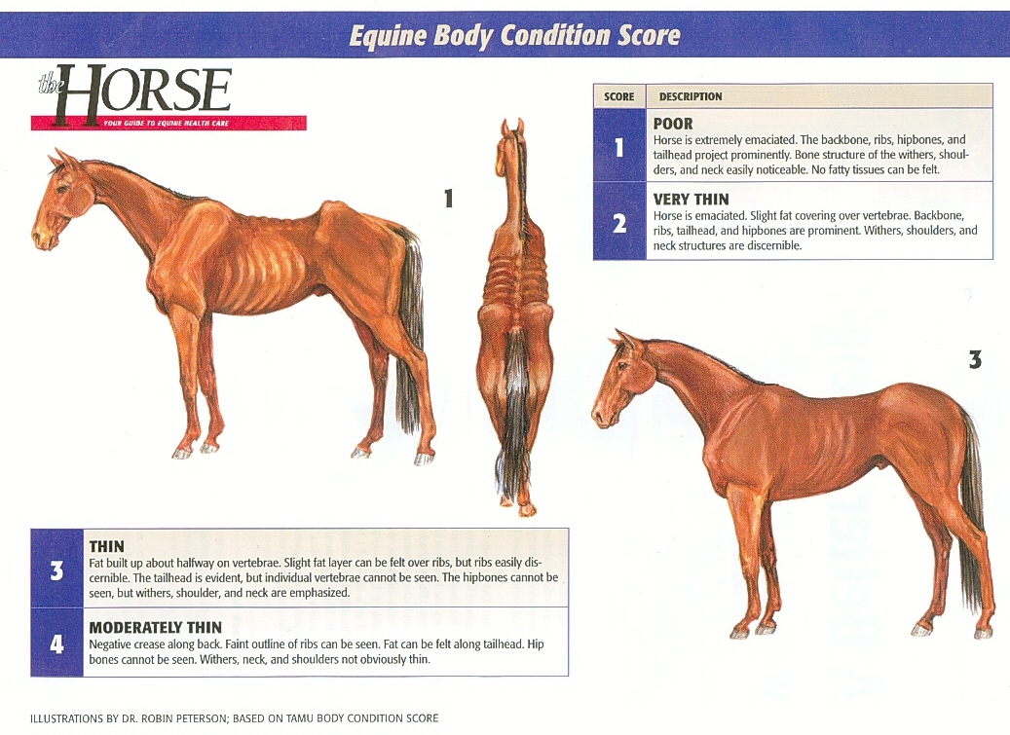
Body Condition Scoring

Slide 19
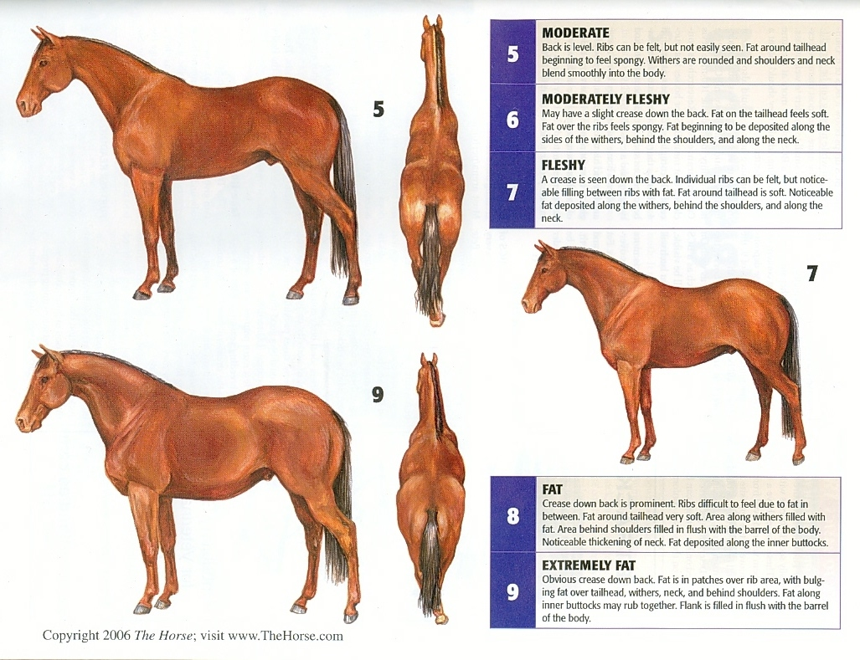
Body Condition Scoring

Slide 20
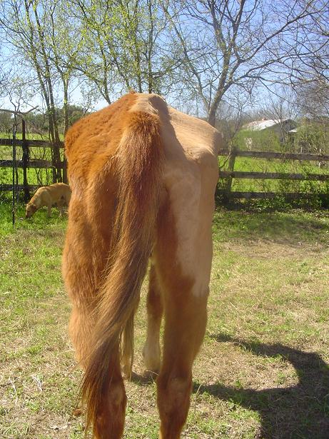
What Score Would this Be?

Slide 21
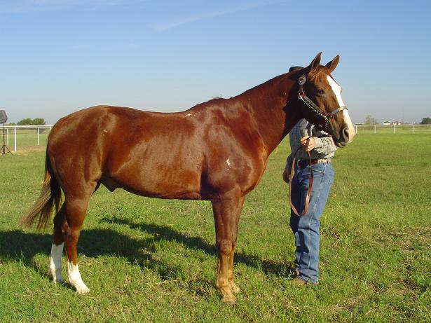
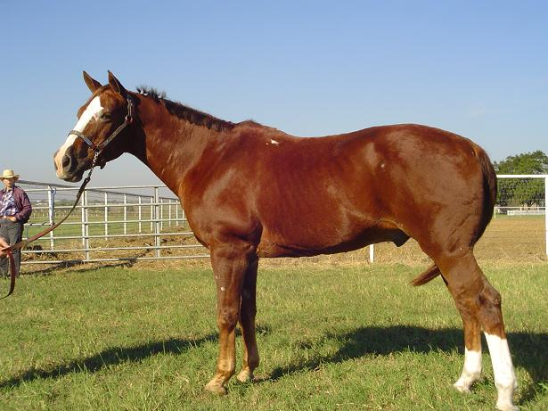
What Score Would this Be?

Slide 22
Movement
Should move in a cadenced manner
Lame vs. Sound
How do we determine lameness
Degrees of lameness
  Grades 1 – 4
What causes lameness
Treatment?

Slide 23
Other Parameters
Hair Coat
  Time of year
  Housing
  Parasite control
  Age
  Etc.
Hoof Condition
  Should be hard, slick shiny surface

Slide 24
Feeding Habits
Typically are content if they can
  Eat and drink at will
What if a horse stops eating?
  May be first sign of a problem
  May not be a problem at all
  Here again, important to know your horse

Slide 25
Behavior
Important to understand
  Eating, drinking, content, disturbed, aggressive, etc.
Abnormal behavior:
  Stall walking
  Weaving
  Cribbing

