Slide 1
Parts, Colors, and Markings
Lecture 5

Slide 2
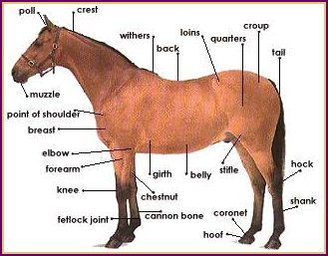
Parts of The Horse

Slide 3
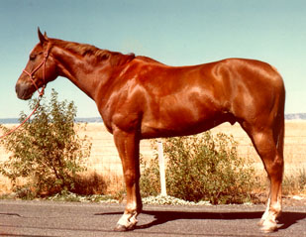
Sorrel
Body
  Reddish or copper red
Mane and tail
  Same
  May be flaxen

Slide 4
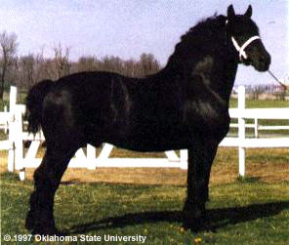
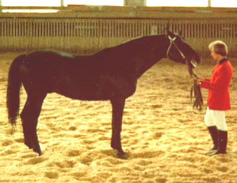
Black
Body color
  True black without light areas
Mane and tail
  Black

Slide 5
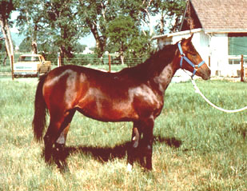
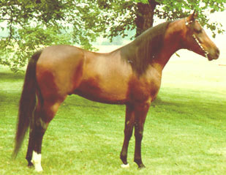
Bay
Body color
  Tan / red / reddish-brown
Mane and tail
  Black
  Black on lower legs

Slide 6
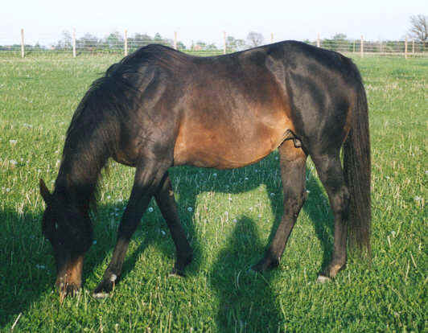
Brown
Body color
  Brown or black
  Light areas
    Muzzle
    Eyes
    Flank
    Inside upper legs
Mane and tail
  Black or brown

Slide 7
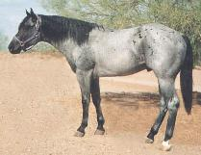
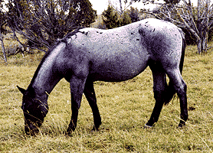
Blue Roan
Body
  Uniform mixture of
  white and black hairs
Dark Points

Slide 8
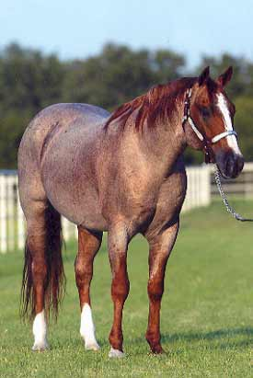
Red Roan
Body
  Uniform mixture of white and red hairs
Red on head & lower legs
Red or flaxen mane & tail

Slide 9
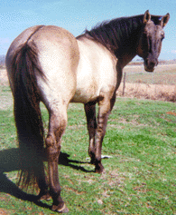
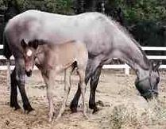
Grullo
Body
  Smoky or mouse-colored
    Not a mixture of black and white hairs
    Each hair mouse colored
Mane and tail
  Black
  Black on lower legs
  Usually has dorsal stripe

Slide 10
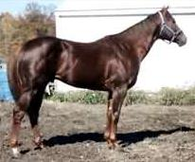
Chestnut or Liver Chestnut
Body
  Dark red or brownish-red
Mane and tail
  Usually dark red
    Brownish red
  May be flaxen
  Lower legs red
  May have dorsal stripe

Slide 11
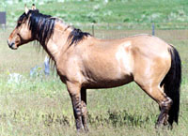
Dun
Body
  Yellowish or gold
Mane and tail
  Black or brown
Dorsal stripe
  Zebra stripes on leg
  Transverse stripe over withers

Slide 12
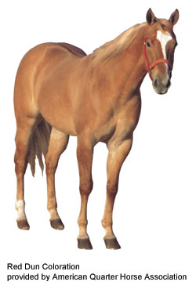
Red Dun
Body color
  Form of dun
  yellowish or flesh colored
Mane and tail
  Red or reddish
  Flaxen
  Red dorsal stripe
  Zebra stripes
  Transverse stripe

Slide 13
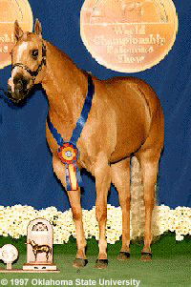
Palomino
Body
  Golden yellow
Mane and tail
  White
  Typically no dorsal stripes

Slide 14
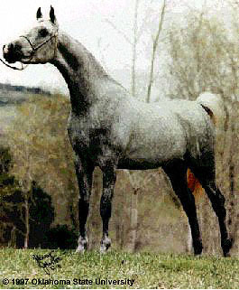
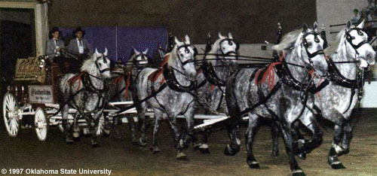
Gray
Body
  Mixture of white with any other colored hairs
Often born solid
Lighter with age
May have dorsal stripe

Slide 15
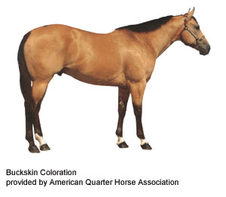
Buckskin
Body Color
  Yellowish or gold
Mane and tail
  Black
  Usually black on lower legs
  Typically do not have dorsal stripes

Slide 16
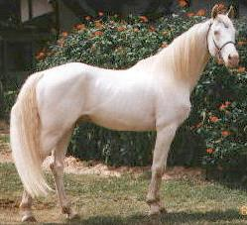
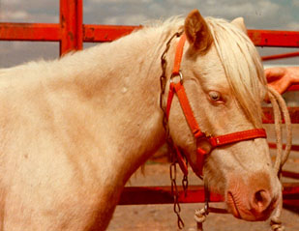
Cremello
Body color
  White or light cream
Mane and tail
  White
  Pink or pinkish skin over entire body
  Blue eyes

Slide 17
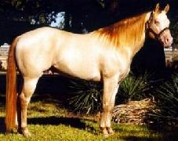
Perlino
Body color
  White or light cream
Mane and tail
  Usually have a darker tint
  Pale copper or orange
  Pink or pinkish skin over entire body
  Blue eyes

Slide 18
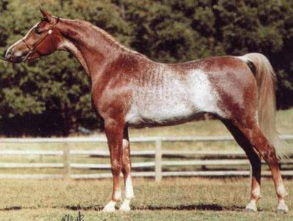
Rabicano
Body
  Interspersed white hairs
    Most dense from
    Flank to tailhead
    Not Roan

Slide 19
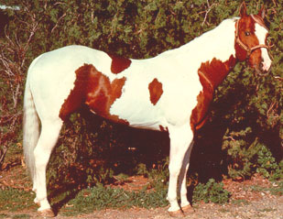
Tobiano
Dark color usually covers
  One or both flanks
Generally
  All four legs are white
  At least below the hocks and knees
Spots
  Regular and distinct appearance of a shield

Slide 20
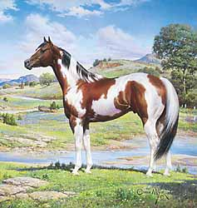
Tobiano
Head markings
  Like solid-colored horse
  May have blaze, strip, star or snip
May be either
  Predominantly dark or white
Tail is often two colors

Slide 21
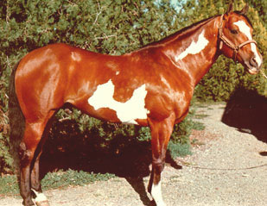
Overo
White
  usually will not cross back
  Between withers and tail
Generally
  At least one and often all four legs dark
  White irregular
    Scattered or splashy

Slide 22
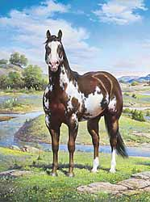
Overo
Head markings often
  Bald-faced
May be either
  predominantly dark or white
Tail usually one color

Slide 23
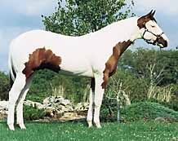
Tovero
Dark pigmentation around ears
May expand to cover
  Forehead and/or eyes
One or both eyes blue
Dark pigmentation around
  Mouth
  May extend up sides of face and form spots

Slide 24
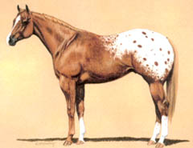
Blanket
Solid white area
Normally over
  Hip area
  Contrasting base color

Slide 25
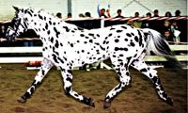
Leopard
Predominantly
  White with spots of color over their body
Sometimes
  Spots more concentrated head and leg areas
Spots may also occur
  Direction hair grows
  Most evident in the flank area

Slide 26
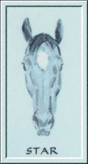
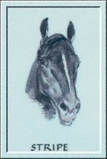
Head Markings
Star: white mark on forehead
Stripe: narrow white mark down the face

Slide 27
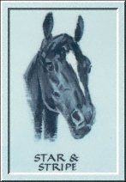
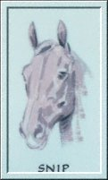
Head Markings
Star & Stripe: connected star and stripe
Snip: white mark between the nostrils

Slide 28
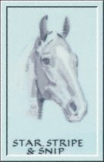
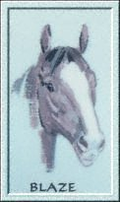
Head Markings
Star, stripe, snip: connected star, stripe, and snip
Blaze: broad white mark down the face, extending over nose

Slide 29
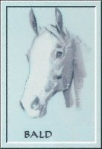
Head Markings
Bald: very wide blaze, covering most of the face extending down over the nostrils

Slide 30
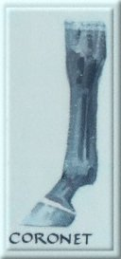
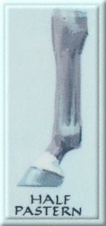
Leg Markings

Slide 31
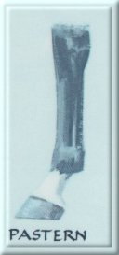
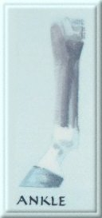
Leg Markings

Slide 32
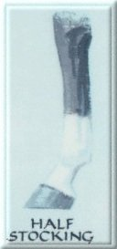
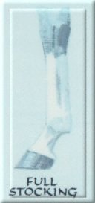
Leg Markings

Slide 33
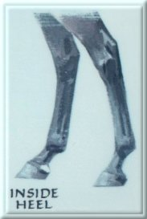
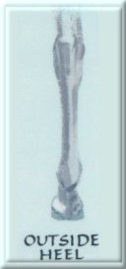
Leg Markings

