Slide 1
Sources of Nutrients
Created by: Arlene Barrett, Dennis Bratton, Mariah Gumphrey, Haley Vrazel

Slide 2
Objective
Evaluate six types of nutrients and their purpose.
Analyze symptoms of nutritional deficiencies.
Assess nutrient levels in a given stage of development.

Slide 3
Six Types of Nutrient
Water
Carbohydrates
Fats
Protein
Vitamins
Minerals

Slide 4
Water
The largest component of nearly all living things.
Muscles and internal organs of animals contain roughly about 75% water.
It serves as a lubricant for all nutrients that enter the body and reacts with chemical compounds to help breakdown food into usable products.
Water also aids in the regulation of body heat, through perspiration and evaporation.
It is important to remember that water is the cheapest nutrient to provide but animals will live only a few days if there is not a source.

Slide 5
Carbohydrates
Carbohydrates are made up of Carbon, Hydrogen, and Oxygen.
Account for 65-80% of the feeds normally consumed by animals.
Cellulose is the most abundant energy source in the world.
Monosaccharides
Glucose, Fructose, Galactose
Disaccharides
Lactose, Maltose, Surocse
Polysaccharides
Startch
Amylose, Amylopectine, Glycogen
Cellulose

Slide 6
Fats
Made up of carbon, hydrogen, and oxygen.
Smaller proportion of oxygen than carbs.
Also called lipids, crude fat, ether extract.
Has 2.25 times as much energy as carbs.
Adding fats to the diet can increase energy intake without increasing the total feed intake.
Fats may be solid (fats) or liquid (oils).
Saturated, Unsaturated, Omega-3 Fatty Acids

Slide 7
Protein
Protein is the major component of tissues and muscles.
Made up of carbon, hydrogen, oxygen, and nitrogen.
The make up of protein is determined by the kind and number of amino acids.
There are approximately 22 different amino acids that make up protein.
There are 10 amino acids that are classified as being essential.

Slide 8
Vitamins
Most animals will either make the vitamins needed themselves or they will be provided for in the ration they are given.
Vitamins are used in the clotting of blood, forming bones, reproduction, lactation, and prevention of certain nervous system disorders.
Organic Compounds
Essential for proper utilization of proteins, fats, and carbs.
Catalyst
Needs in small amounts
In two major groups.
Fat soluble (A,D,E,K)
Water soluble (B complex and C)

Slide 9
Minerals
Minerals in animals are required in minimal quantities but they are very important as they are the catalyst for other body processes
Divided into two major categories:
Macro Minerals (needed in larger quantities)
Micro Minerals (needed in smaller quantities)
Macro
Ca
P
Mg
K
Na
S
CL
Micro
Cu
Cr
Fe
F
Mn
Se
Mo
Si
Zn

Slide 10
Symptoms of Nutritional Deficiencies
Protein -- decreased growth and development, especially where muscles are concerned, decreased feed intake, poor coat (meaning dull, rough, losing hair, etc)
Minerals -- rickets, weak bones, decreased milk production
Vitamins -- impaired vision, respiratory illness, weakness, digestive disturbances
Carbohydrates and Fats -- decrease in weight, condition and energy, unthrifty appearance

Slide 11
Nutrient Levels
Stage of development
These are maintenance, growth, reproduction and production. There are periods in an animal’s life they will fulfill 3 of the functions and nutrient requirements are going to be different for those animals versus those simply completing the maintenance function

Slide 12
Stage of development
Maintenance: Support of an animal when doing no work and yielding no product. Nutrients are used to build and renew tissues and organs. Nearly one-half of feed consumed by animals is used for maintenance with the remainder fulfilling the needs of the other functions or towards the production of meat, milk, wool or work.
Growth: The general development of an animal from the time it is born until it has reached maturity. Nutrients for this function are needed in addition to those needed for growth. Adequate nutrients are extremely important for the development of young animals so they are able to meet their potential of size and capacity and are used to produce new cells and tissues.

Slide 13
Stage of development
Reproduction: This time period is from conception until the birth of the new animal. It is important to prevent over-feeding pregnant animals, even though nutrients are used primarily for the development of the fetus. Underfeeding, which results in deficiencies of certain vitamins, minerals and proteins, will also be detrimental to the newborn.
Production: Animals being fed for production of market animals such as those for meat, milk, wool and work. Feed given for production is the most costly portion and it is vital the proper amount of feed with the correct mixture of ingredients be fed for these animals. As animals become older and fatter, they consume less feed and use more for maintenance. It is imperative that proper quantity and quality of feeds be fed to producing animals to yield the best net returns for the feed fed.

Slide 14
Review
Evaluate six types of nutrients and their purpose.
Analyze symptoms of nutritional deficiencies.
Assess nutrient levels in a given stage of development.

Slide 15
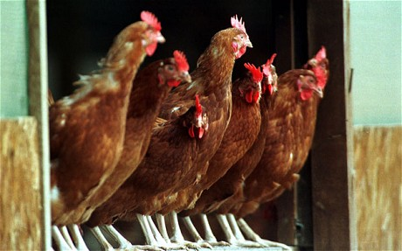
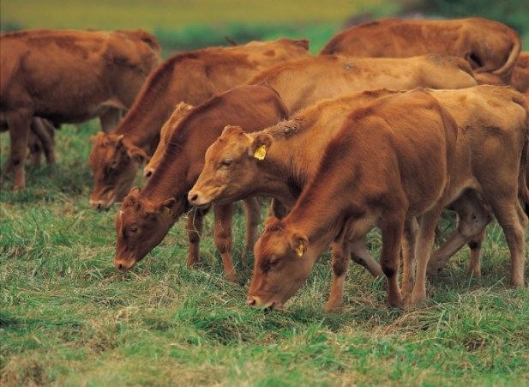
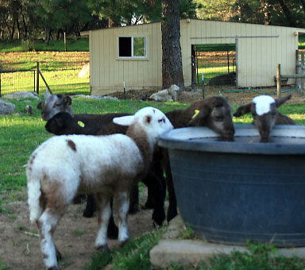
Lab Activity
Animal Nutrition Needs worksheet.

Slide 16
References
Animal Science Packet
Sam Houston State University
Lesley A. Rakowitz-McMuillian

