Slide 1
Evolution and Domestication of the Horse
Equine Science
Unit 1, Section A-F
Mrs. Martin
2012-2013

Slide 2
What is Domestication?
Domestication involves more than simply taming.
Animals are considered to be domesticated when:
they are kept for a distinct purpose
humans control their breeding
their survival depends on humans
they develop traits that are not found in the wild

Slide 3
Domestication - Continued
Domestication allowed humans to:
Contain animals with the right temperament
Have a steady supply of food
Use animals for companionship, religious purposes and draft work
In return, the horses received protection and a constant food supply.
Selective breeding occurred as humans got rid of animals with undesirable traits, not allowing them to reproduce.

Slide 4
What was the primary use horses were domesticated for?
Originally, horses were used for meat and milk, but eventually became useful as pack and draft animals.
Eventually, horses were domesticated primarily for transportation and draft work purposes.

Slide 5
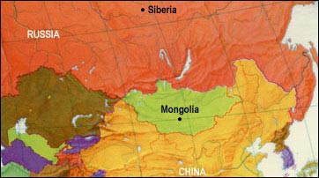
When and Where were Horses Domesticated?
Horses Domesticated approx. 5,000 years ago
Horses were domesticated in Eastern Europe and Western Asia. This area includes the areas of Mongolia and Siberia.

Slide 6
Evolutionary Phases of the Horse
Eohippus
Mesohippus
Merychippus
Pliohippus
Equus

Slide 7
Genus & Species of the Modern Horse
Equus Caballus:
Generally described as an odd-toed, ungulate mammal of at least 14.2HH.
The modern horse is one of the 10 living species of the family Equidae.

Slide 8
Horses Used in History
Food
Believe it or not, the State of Texas exports over 300,000 horses to Japan each year for human consumption.
The U.S. is one of the largest exporters.
Many European countries still use horsemeat
This is NOT a common food, however. It is usually consumed by immigrant groups in most Industrialized European Nations.

Slide 9
Horses Used in History
Military
Chariot races were one of the first known uses of horses in sport.
The Bible tells of chariots multiple times. Most notably for some is the story of Moses parting the Red Sea where the Pharaoh of Egypt used chariots to chase after the fleeing Israelites.
Pharaoh's chariots actually made Egypt a super-power of his time.
The United States Calvary: Horses moved soldiers and provided power to move supplies and equipment to the battle area.
Revolutionary and Civil War were both dependent on horses.
The U.S. Army used few horses and mules during WWI & WWII.
The use of the horse in the United States Military was officially discontinued in 1948.

Slide 10
Horses Used in History
Power
Mining Industry – Smaller breeds were used to pull ore out of the mines and larger breeds were used to transport wagons full of the ore extracted from the mines.
Timber Industry – Used to pull trees to the saw mills

Slide 11
Horses Used in History
Transportation
In the Bible horses and donkeys were often referred to as transportation methods.
Mary riding the donkey into Jerusalem.
Horse power was used in road building.
Later, horses pulled wagons, buggies, and stagecoaches over the roads that had been constructed.
Horses helped link some off the most remote areas in our country.
Amish people still use horses and buggies for transportation.

Slide 12
Horses Used in History
In Texas, horses were used to help draw county lines.
The intention was that no citizen would ever be more than a day’s ride from the County Seat.
This is how Texas ended up with the most counties in the Nation…. A whopping 254 counties!

Slide 13
Horses Used in History
Recreation
Chariot races
Match races
Form of racing used in the early colonial days
Today’s Racing Industry
Equestrian Shows
Rodeo

Slide 14
Horses Used in History
Agriculture
Horses were used to pull the first plows and disks.
Horses were also used to pull wagons during harvesting.
Back breaking work: Could only harvest 3-4 bushels a day.
The modern combine allows us to do from 3-10 bushels in a single hour.
Pulled hay wagons at feeding time.
The Amish and some more conservative Mennonites in Mid-Western States still use horses to plow, cultivate, and plant their land.

Slide 15
Horses Used in History…
Communication
The British are coming! - Paul Revere’s Midnight Ride
When British Army activity on April 7, 1775, suggested the possibility of troop movements, Joseph Warren sent Revere to warn the Massachusetts Provincial Congress, then sitting in Concord, the site of one of the larger caches of Patriot military supplies.
After delivering the warning, Concord residents began moving the military supplies away from the town. This is one of the most pivotal points in the American Revolution.
Between 9 and 10 p.m. on the night of April 18, 1775, Joseph Warren told Revere and William Dawes that the king's troops were about to embark in boats from Boston bound for Cambridge and the road to Lexington and Concord.
Warren's intelligence suggested that the most likely objectives of the regulars' movements later that night would be the capture of Adams and Hancock. They did not worry about the possibility of regulars marching to Concord, since the supplies at Concord were safe, but they did think their leaders in Lexington were unaware of the potential danger that night. Revere and Dawes were sent out to warn them and to alert colonial militias in nearby towns.

Slide 16
Horses Used in History…
In the days before April 18, Revere had instructed Robert Newman, the sexton of the North Church, to send a signal by lantern to alert colonists in Charlestown as to the movements of the troops when the information became known.
In what is well known today by the phrase
"one if by land, two if by sea",
one lantern in the steeple would signal the army's choice of the land route while two lanterns would signal the route "by water" across the Charles River.
Revere first gave instructions to send the signal to Charlestown. He then crossed the Charles River by rowboat, slipping past the British warship HMS Somerset at anchor.
Crossings were banned at that hour, but Revere safely landed in Charlestown and rode to Lexington, avoiding a British patrol and later warning almost every house along the route. The Charlestown colonists dispatched additional riders to the north

Slide 17
Horses Used in History…
Pony Express
Was a private venture, fast mail service crossing the Great Plains, the Rocky Mountains, and the High Sierra from St. Joseph, Missouri, to Sacramento, California, from April 3, 1860 to October 1861.
It became the west's most direct means of east-west communication before the telegraph and was vital for tying California closely with the Union just before the American Civil War.

Slide 18
Horses Used in History…
This original fast mail 'Pony Express' service had messages carried by horseback riders in staged relays to stations (with fresh horses and riders) across the prairies, plains, deserts, and mountains of the Western United States.
It reduced the time for messages to travel between the Atlantic and Pacific coasts to about ten days, with telegraphic communication covering about half the distance across the continent and mounted couriers the rest.
Lasted only 18 months, but you can still send mail via the Pony Express at least once a year as today the Express is mostly ceremonial and for fun.

Slide 19
Horses in U.S. History
According to the discovery of certain fossils, horses roamed the U.S. millions of years ago.
There were no horses found in 1492 when Columbus discovered America.
The Spanish Conquistadors are credited with re-introducing the horse to America.

Slide 20
What is a Breed?
A breed is generally defined as a viable, true breeding population, and it’s members are called “purebred”.
In most cases, bloodlines are recorded with a breed registry.

Slide 21
Common Horse Breeds
American Quarter Horse
Thoroughbred
Arabian
Appaloosa
Clydesdale
Percheron
Lipizzan
Shetland Pony
Welsh Pony

Slide 22
What is a Breed Registry?
A breed registry, also known as a stud book or register, is an official list of animals within a specific breed whose parents are known.
Animals are usually registered by their breeders when they are still young.
The terms "stud book" and "register" are also used to refer to lists of male animals "standing at stud", that is, those animals actively breeding, as opposed to every known specimen of that breed.

Slide 23
Breed Registry… Continued.
Such registries usually issue certificates for each recorded animal, called a
Pedigree
Pedigreed animal documentation
or most commonly, an animal's "papers".

Slide 24
Breed Registry… Continued
Registration papers may consist of:
a simple certificate
a listing of ancestors in the animal's background, sometimes with a chart showing the lineage

Slide 25
American Quarter Horse
American breed of horse that excels at sprinting short distances.
Name came from its ability to outdistance other breeds of horses in races of a quarter mile or less
some individuals have been clocked at speeds up to 55 mph.

Slide 26
American Quarter Horse…
The American Quarter Horse (AQHA) is the most popular breed in the United States.
AQHA is the largest breed registry in the world
more than 5 million American Quarter Horses registered.

Slide 27
American Quarter Horse
The compact body of the Quarter Horse is well-suited to the intricate and speedy maneuvers required in:
reining
Cutting
working cow horse
barrel racing
calf roping
other western riding events, especially those involving live cattle.
Quarter horses are also used in English riding, driving, and many other disciplines.

Slide 28
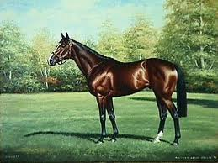
Thoroughbred
Thoroughbreds are considered "hot-blooded" horses, known for their agility, speed and spirit. Known mostly for racing.
The Thoroughbred as it is known today was developed in 17th- and 18th-century England, when native mares were crossbred with imported Oriental stallions of Arabian, Barb, and Turkoman breeding.
All modern Thoroughbreds can trace their pedigrees to three stallions.

Slide 29
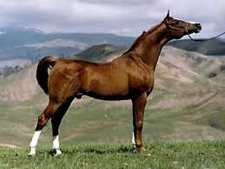
Arabian
breed of horse that originated on the Arabian Peninsula.
distinctive head shape and high tail carriage, the Arabian is one of the most easily recognizable horse breeds in the world.
One of the oldest breeds, with archaeological evidence of horses that resemble modern Arabians dating back 4,500 years.

Slide 30
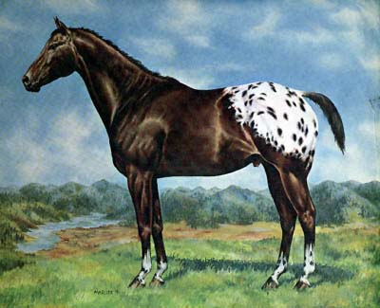
Appaloosa
best known for its colorful leopard-spotted coat pattern. There is a wide range of body types within the breed, stemming from the influence of multiple breeds of horses throughout its history.
Each horse's color pattern is genetically the result of various spotting patterns overlaid on top of one of several recognized base coat colors.
Gene mutation: Leopard Complex Mutation (LP)

Slide 31
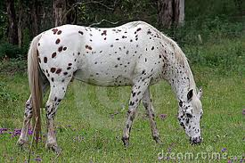

Slide 32
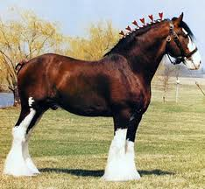
Clydesdale
breed of draught horse derived from the farm horses of Clydesdale, Scotland, and named after that region.
Although originally one of the smaller breeds of draught horses, it is now a tall breed.
Often bay in colour, they show significant white markings due to the presence of sabino genetics.

Slide 33
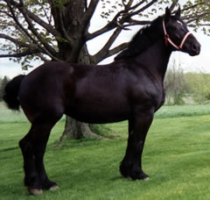
Percheron
breed of draft horse that originated in the Huisne river valley in northern France, part of the former Perche province from which the breed takes its name.
Usually gray or black in color, Percherons are well-muscled, and known for their intelligence and willingness to work.
Although their exact origins are unknown, the ancestors of the breed were present in the valley by the 17th century.
They were originally bred for use as war horses.

Slide 34
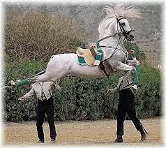
Lipizzan
The Lipizzan breed dates back to the 16th century, when it was developed with the support of the Habsburg nobility.
The breed takes its name from one of the earliest stud farms established, located near the Kras village of Lipica (spelled "Lipizza" in Italian), in modern-day Slovenia.

Slide 35
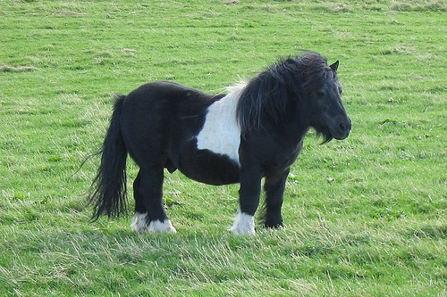
Shetland Pony
breed of pony originating in the Shetland Isles.
Range in size from a minimum height of approximately 28 inches to an official maximum height of 42 inches (10.2 hands, 107 cm) at the withers. (11.2 hands for American Shetlands)
Shetland ponies have heavy coats, short legs and are considered quite intelligent.
They are a very strong breed of pony, used for riding, driving, and pack purposes.

Slide 36
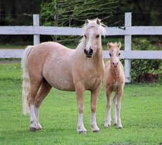
Welsh Pony
originated in Wales in the United Kingdom.
Breed Society has four sections, primarily distinguished by height, but also by variations in type:
the Welsh Mountain Pony (Section A),
the Welsh Pony (Section B),
the Welsh Pony of Cob Type (Section C),
the Welsh Cob (Section D).
known for their good temperament, hardiness, and free-moving gaits.

Slide 37
Colors… And what’s the difference?
Not all breeds are specific to color.
Some breeds have members of various colors, while other breeds have a color standard.
For a color standard example:
The Lipizzaners -
All are born black and become white with age.
Non-Color Standard –
The American Quarter Horse –
Breed members can be of almost any color and combination.

Slide 38
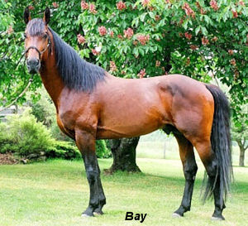
Common Colors and Combinations
Bay:
characterized by a reddish brown body color with a black mane, tail, ear edges, and lower legs.

Slide 39
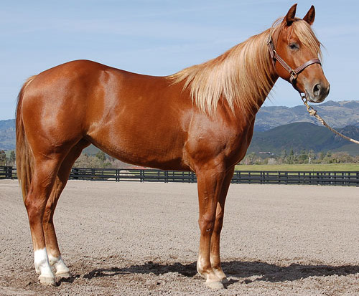
Colors Continued….
Chestnut:
consisting of a reddish-to-brown coat with a mane and tail the same or lighter in color than the coat.
Genetically and visually, chestnut is characterized by the absolute absence of true black hairs.
It is one of the most common horse coat colors, seen in almost every breed of horse.

Slide 40
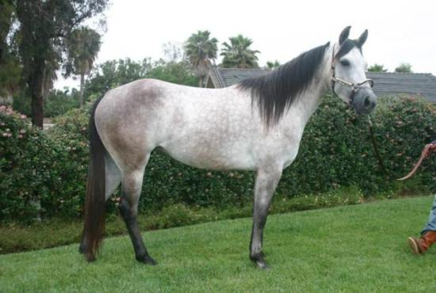
Colors Continued….
Grey:
characterized by progressive silvering of the colored hairs of the coat.
Most gray horses have black skin and dark eyes; unlike many depigmentation genes, gray does not affect skin or eye color.
Their adult hair coat is white, dappled, or white intermingled with hairs of other colors. Gray horses may be born any base color, depending on other color genes present.

Slide 41
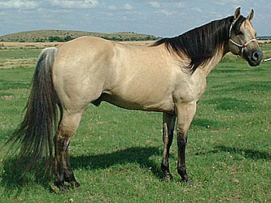
Colors Continued….
Buckskin:
referring to a color that resembles certain shades of tanned deerskin.
tan or gold colored coat with black points (mane, tail, and lower legs).
Buckskin occurs as a result of the cream dilution gene acting on a bay horse.

Slide 42
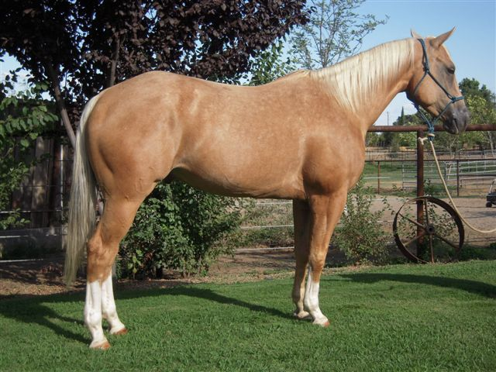
Colors Continued….
Palomino:
consisting of a gold coat and white mane and tail.
Genetically, the palomino color is created by a single allele of a dilution gene called the cream gene working on a "red" (chestnut) base coat.

Slide 43
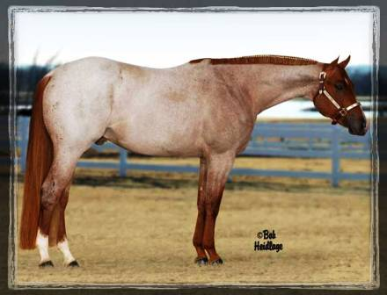
Colors Continued….
Strawberry or Red Roan:
an even mixture of white and pigmented hairs that does not "gray out" or fade as the animal ages.
describes true or classic roan on a chestnut base coat.
The mane and tail remain red or have only a few white hairs, while the body ranges from nearly chestnut to pinkish.

Slide 44
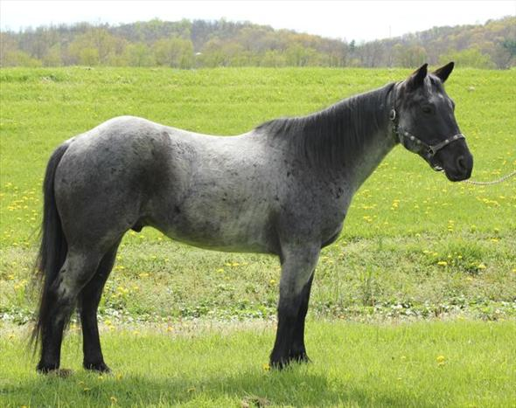
Colors Continued….
Blue Roan:
true roan on a black coat. The mane, tail, head, and legs remain black, while the body takes on a grayish or bluish appearance.
Blue roans are sometimes mistaken for grays or grullos. However, Grays fade with age, while roans do not.
And grullos are blue duns and possess dun markings but not intermingled white hairs.

Slide 45
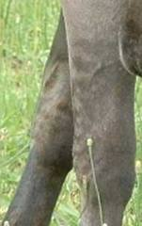
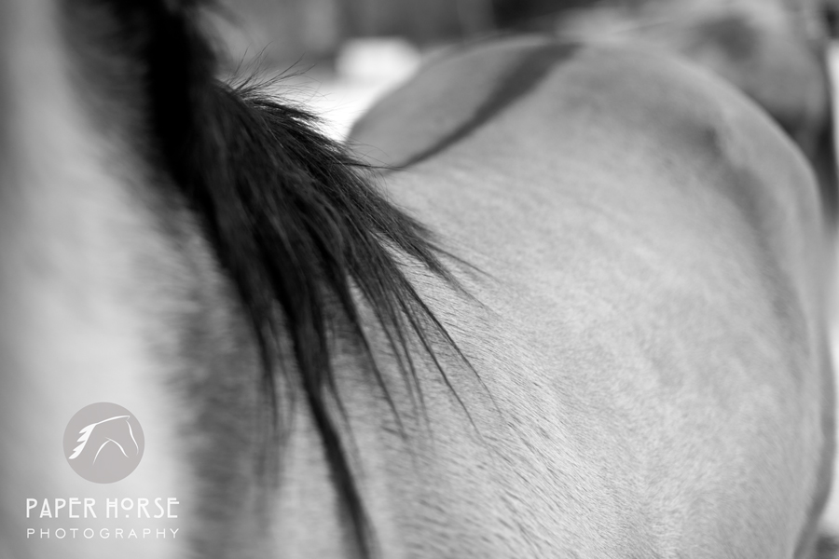
Colors Continued….
Grulla:
in the dun family
characterized by tan-gray or mouse-colored hairs on the body, often with shoulder and dorsal stripes and black barring on the lower legs.
In this coloration, each individual hair is mouse-colored, unlike a roan which is composed of a mixture of dark and light hairs.

Slide 46
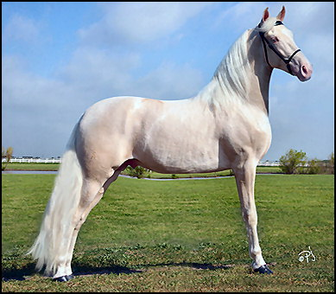
Colors Continued….
Cremello
creamy or golden coat, white tail, white mane, blue eyes and pinkish skin.
Cremello horse color often results when the horse has a cream gene that acts on a base coat of chestnut red.
Many foals of this hue eventually “fade” and look white as they grow older.

Slide 47
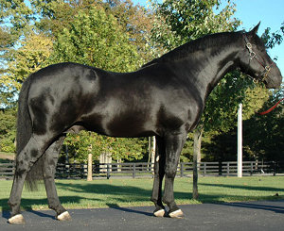
Colors Continued….
Black:
The entire hair coat is black.
Black is a relatively uncommon coat color, and novices frequently mistake dark chestnuts or bays for black.
Some breeds of horses, such as the Friesian horse, Murgese and Ariegeois (or Merens) are almost exclusively black.

Slide 48
Types of Horses
Horse type refers to what the horse is used for.
There are 4 types of horses
Riding
Gaited horses: Saddle bred, walking horse, Missouri Foxtrotter
Stock: Morgan, Quarter horse, and Mustang
Polo: Thoroughbreds and Crossbreds.
Hunters and Jumpers: Thoroughbreds, Warmbloods, Welsh Ponies
Ponies: Shetlands, Welsh
Racing
Running: Thoroughbred, Quarter Horse
Harness: Standard bred
Driving
Harness: Hackney, American Saddlebred, Standard Bred
Roadsters: Standardbred
Ponies: Hackney, Welsh, Shetland
Draft
Large wagons and coaches: Clydesdale, Percheron, Belgian, Suffolk

Slide 49
Size Classifications
There are 5 Classifications of Horses
Miniature
Under 34” and is generally a “sized down” horse.
Pony
Under 13.2 hands and weighing 500-900 lbs.
Light Horse
14.2 – 17 hands and 900-1400 lbs.
Draft Horse
14.2 – 17.2 hands and over 1400 lbs.
Warmbloods
16 – 17.2 hands and 1200-1400 lbs.
Cross between a draft horse and a light breed.

Slide 50
How to Determine Size
Horses are measured in hands.
One “hand” is equal to 4 inches.
Miniature horses can be measured in centimeters, inches, or hands.
When measuring a horse in inches, divide the inches by 4. Partial hand widths are measured in inches.
Horse A: 62” ÷ 4 = 15.2 HH

Slide 51
How to Determine Size
Horses are measured from the ground, just beside and behind a front foreleg to the top of the withers or fifth vertebrae.
This is the one part of the horse’s top line that does not change whether he lowers or raises his head or drops or arches his back.
This is standard, regardless of what increments, hands, and centimeters or inches you use, what country you are in, what discipline your ride or breed of horse or pony.

